Slide 1
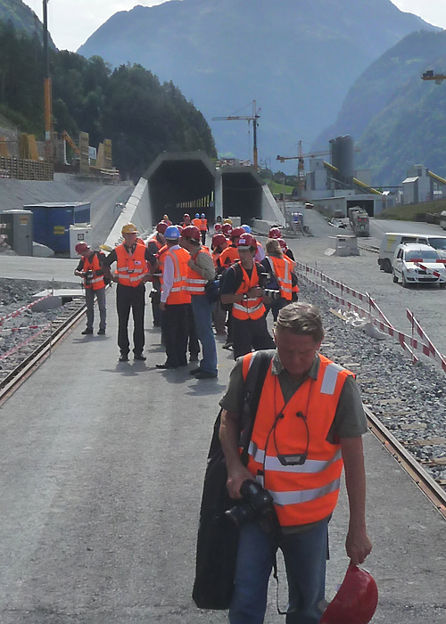
Underground Past & Future :
Worm’s Wisdom or Ostrich’s Syndrome ?
Infrastructure Past & Present
Realism or Terribilità ?
Architecture between Infra & Supra
Questions & Digressions
JG
TU Delft
May 22
2014

Slide 2
Articulation
1
Art & the Industrial Revolution : on the steps of F.D. Klingender
2
From the Metropolis to the Alps :
From the Thames to the Gotthard
After the necessary exaltation of the sublime, the realistic intellectual & graphical operation of the section will be praised.
Case studies should sketch the centrality & synthetic program of the tunnel : a platform for the polytechnicien encounter of the disciplines a vector of speed applied to the city (London) & continental geography (Gotthard). Digressions might bring precision on difficult problems.

Slide 3
Thanks to
Francis Donald Klingender
(1907-1955)
Art & the Industrial Revolution (1947)
L(ionel) T(homas) C(aswal) Rolt (1910-1974)
Isambard Kingdom Brunel (1957)
Jean-Louis Cohen
Salomon Frausto
Ricardo Simian

Slide 4
What is the quintessence of Dutch technical & poetical imagination ?

Slide 5

Carrot seeds sold in
Basel CH
April 2014

Slide 6
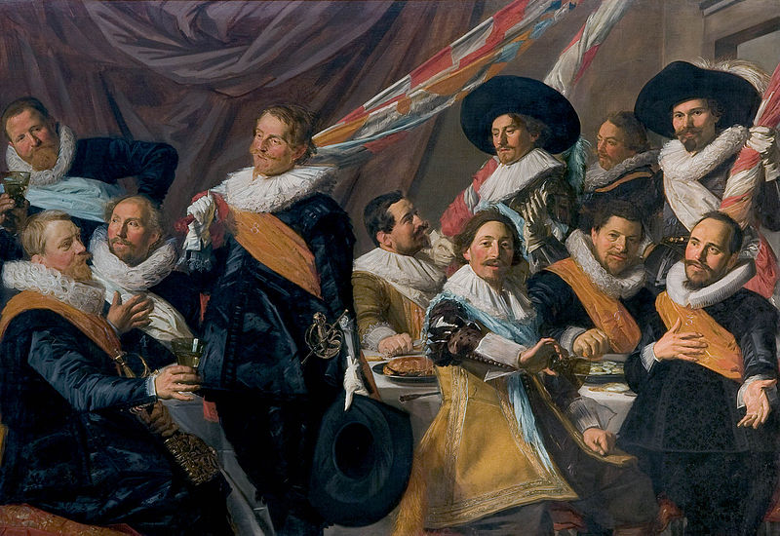
Frans Hals (c.1582-1666) St George Civic Guard in Haarlem, 1627, Frans Hals Museum Haarlem

Slide 7
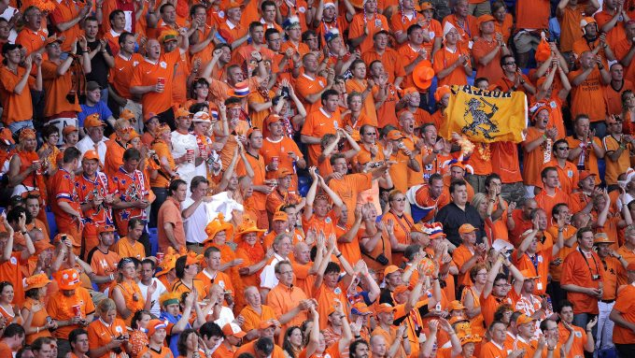
Bern, Wankdorf Stadium, June 9, 2008, Holland 3 Italy 0

Slide 8
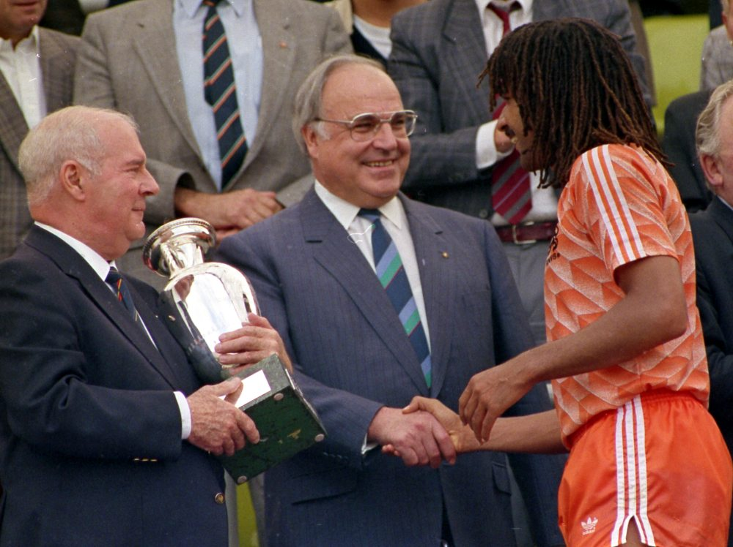
Munich June 28, 2008
Holland 3 Russia 1

Slide 9
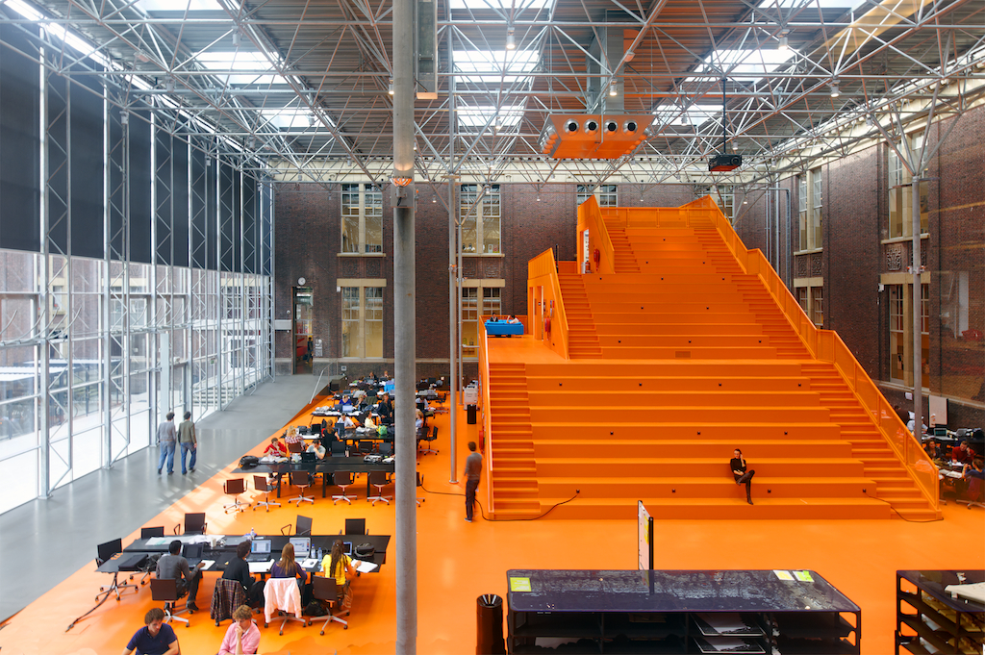
The Why Factory, MVRDV, TU Delft, November 2013, Source: TU whyfactory021

Slide 10
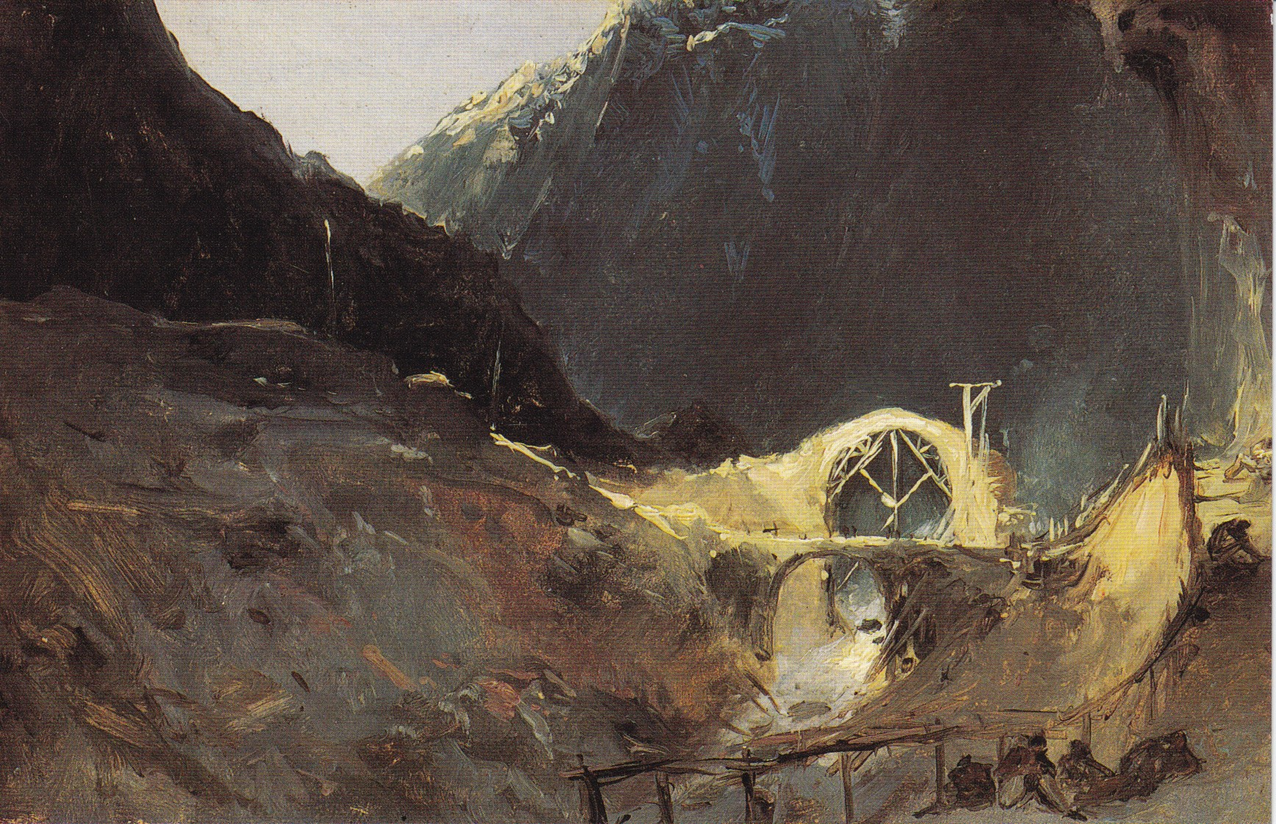
Carl Blechen (1798-1840) Teufelsbrücke on the Gotthard Pass, 1828 circa
Oil on paper, Oskar Reinhart Stiftung, Winterthur

Slide 11
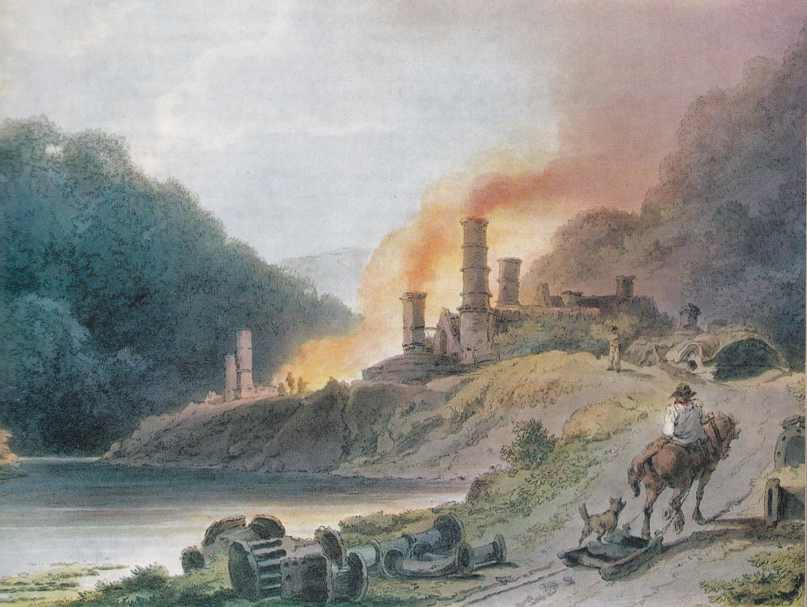
William Pickett (≈1792-1820) Colebrook Dale Iron Works, 1805, aquatint from PJ Loutherbourg, Picturesque Scenery of England & Wales, 1805

Slide 12
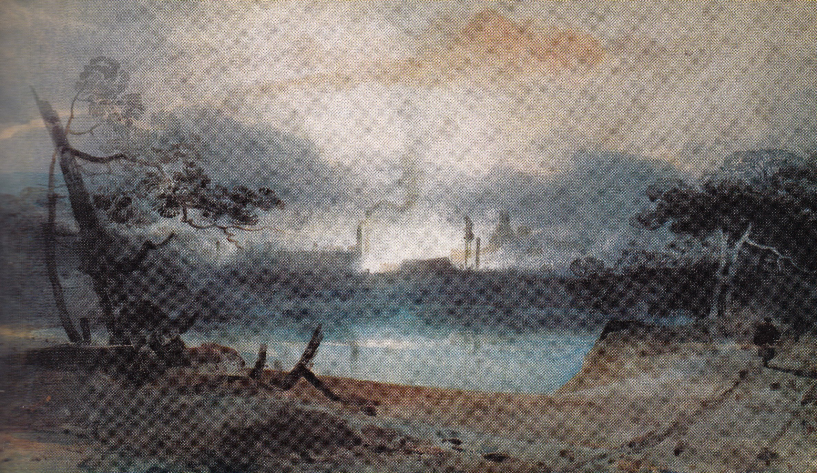
John Sell Cotman (1782-1842) Bedlam Furnace at Ironbridge, 1802 from FD Klingender, Art & the Industrial Revolution (1947)
2nd edition, 1968

Slide 13
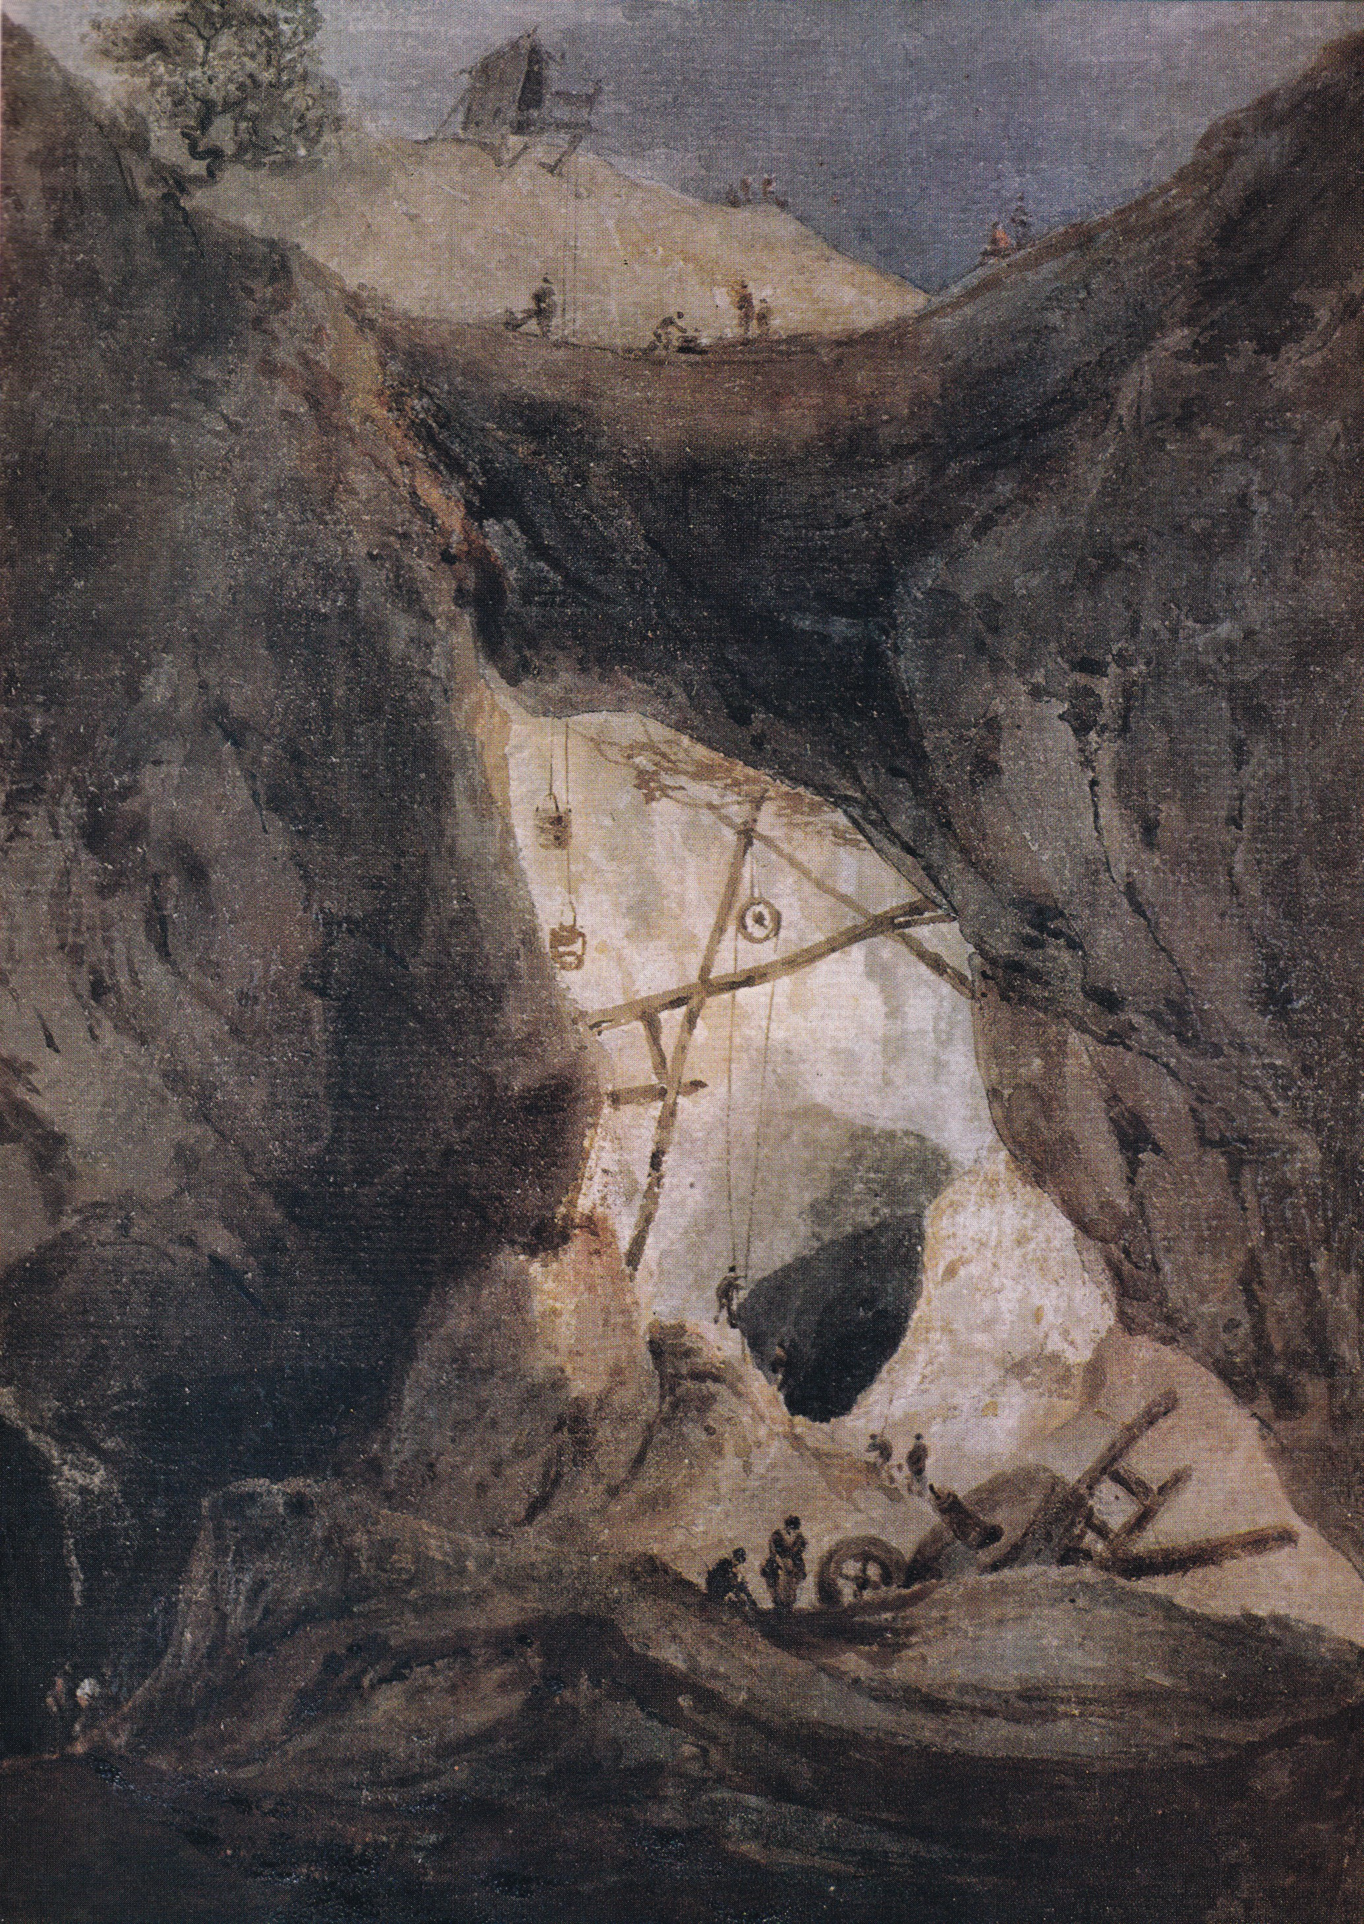
François Thomas Louis Francia (1772-1839)
The Parys Copper Mine in Anglesea, Wales watercolour, 1805 circa from FD Klingender, 1968

Slide 14
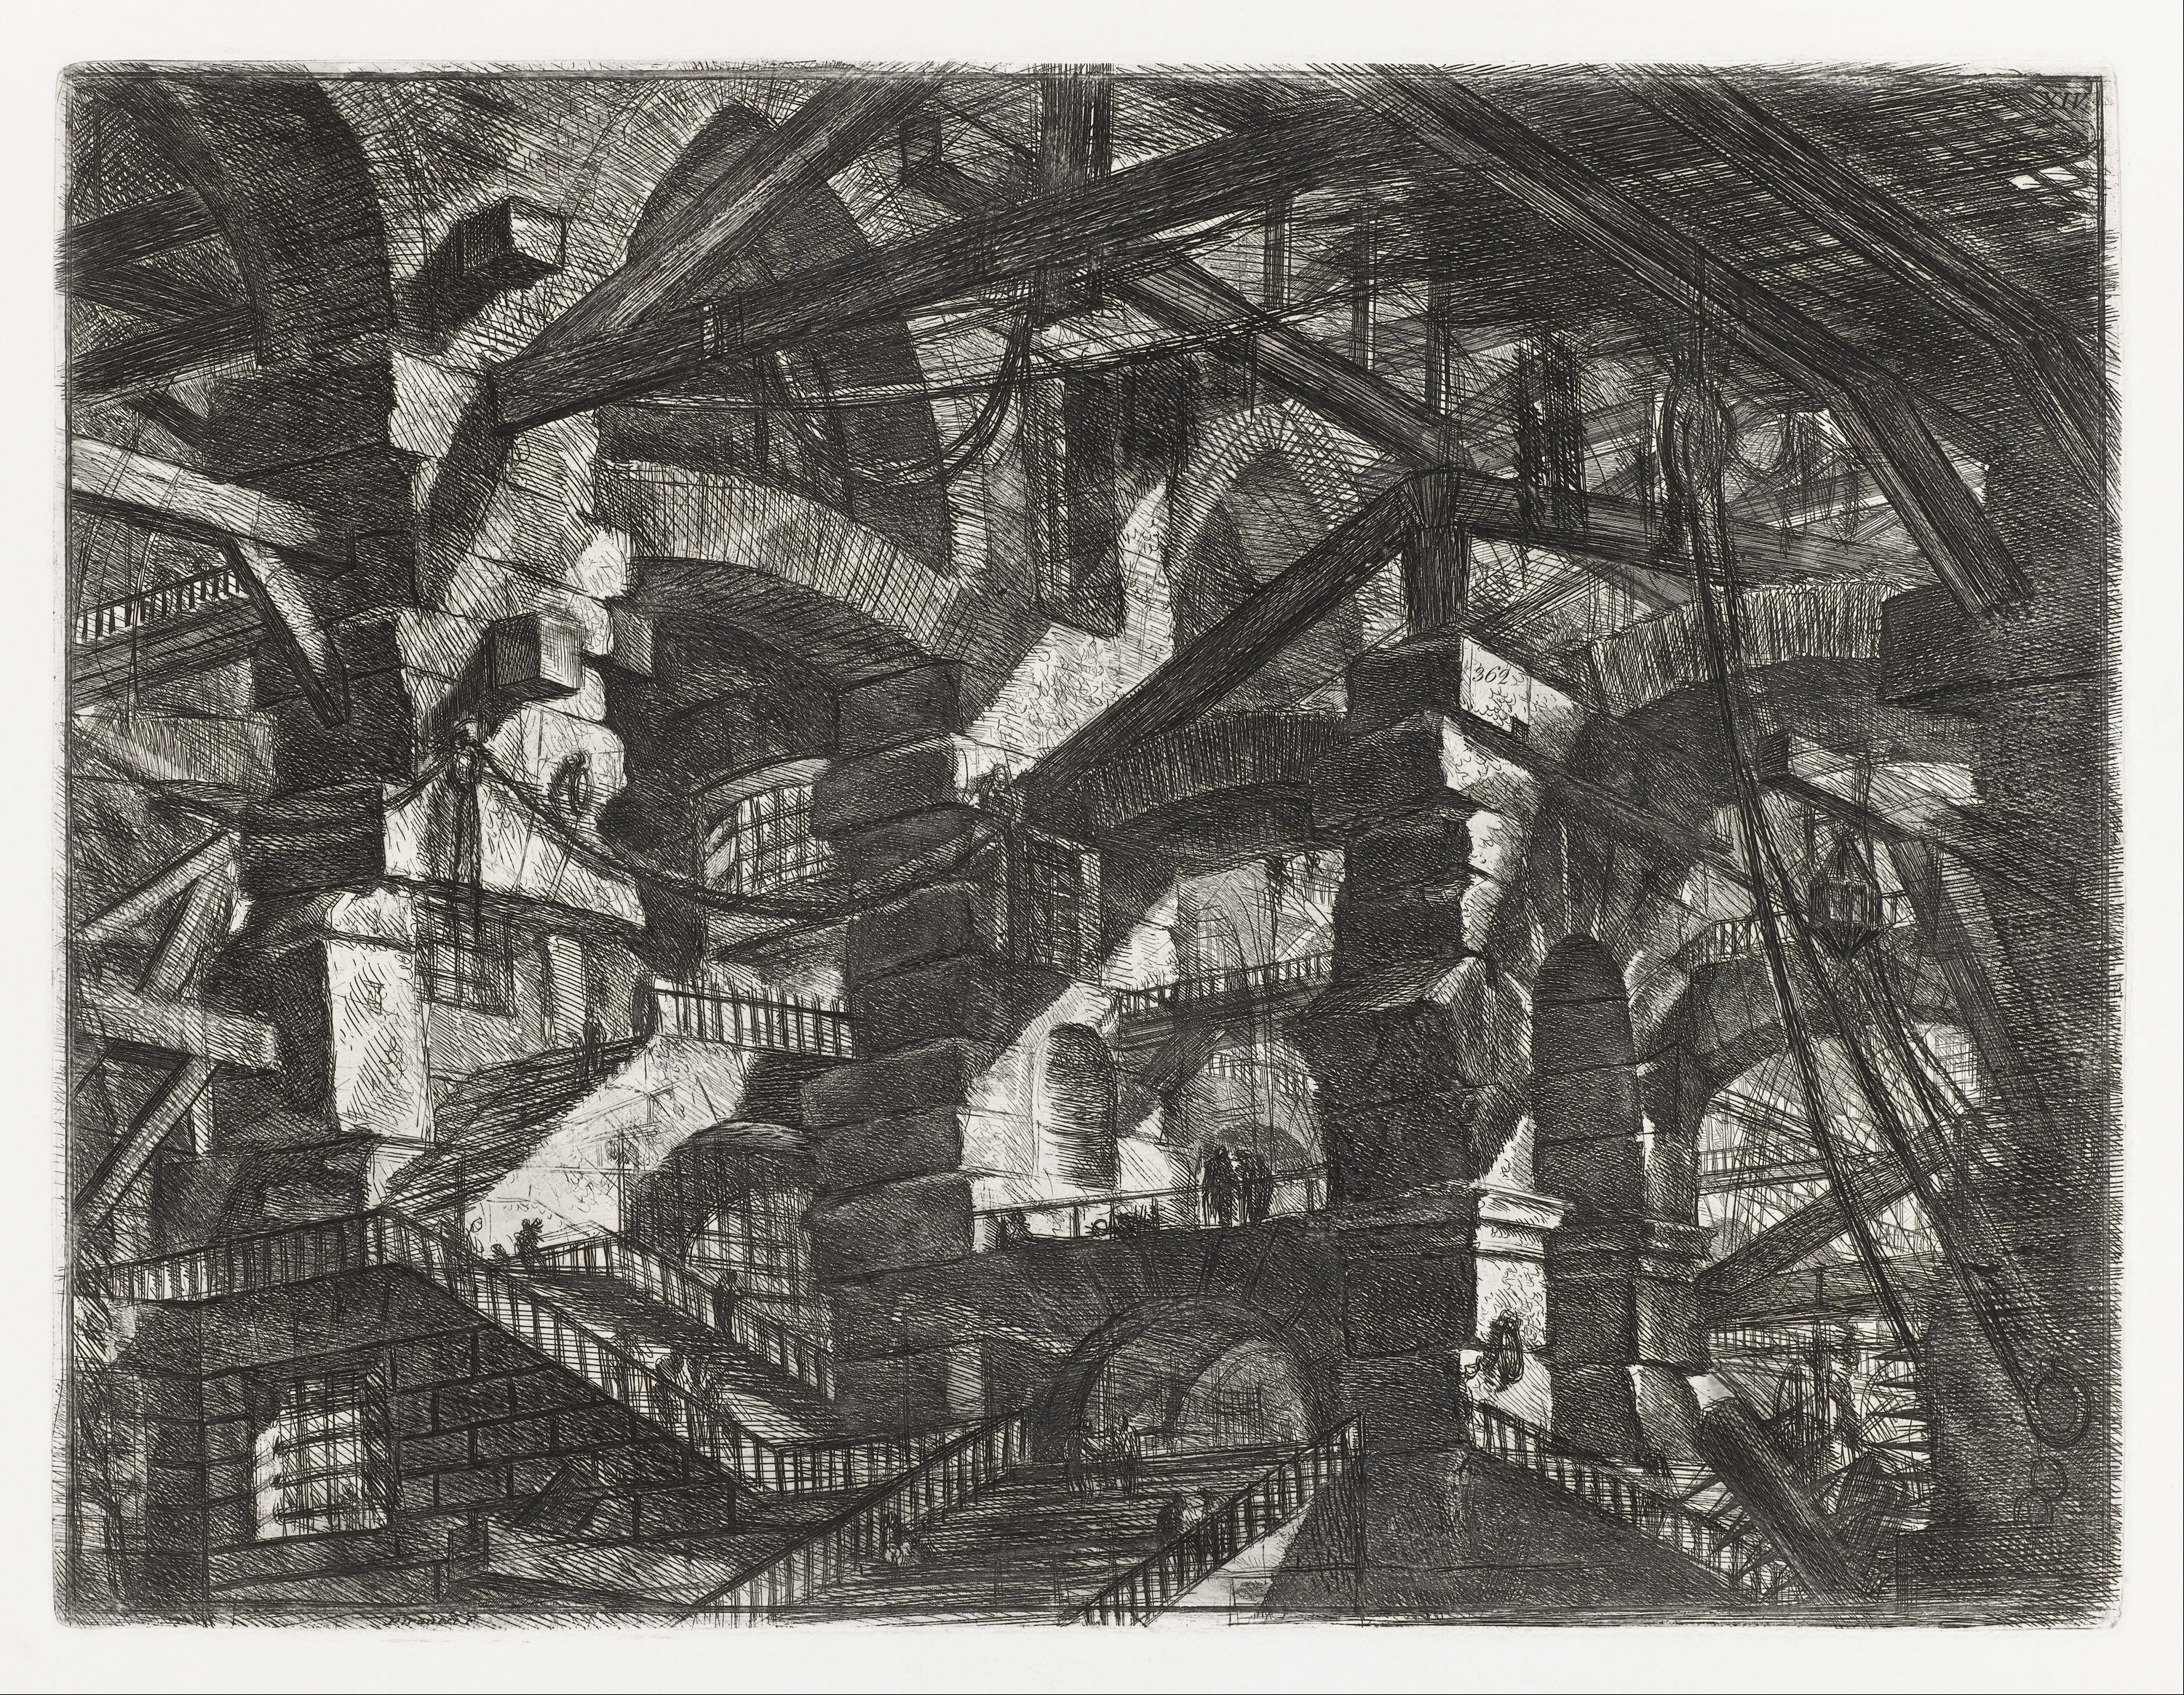
Giovanni Battista Piranesi, Carceri d’invenzione, plate XIV, 1745 from Cooper Hewitt National Design Museum, NY, NY

Slide 15
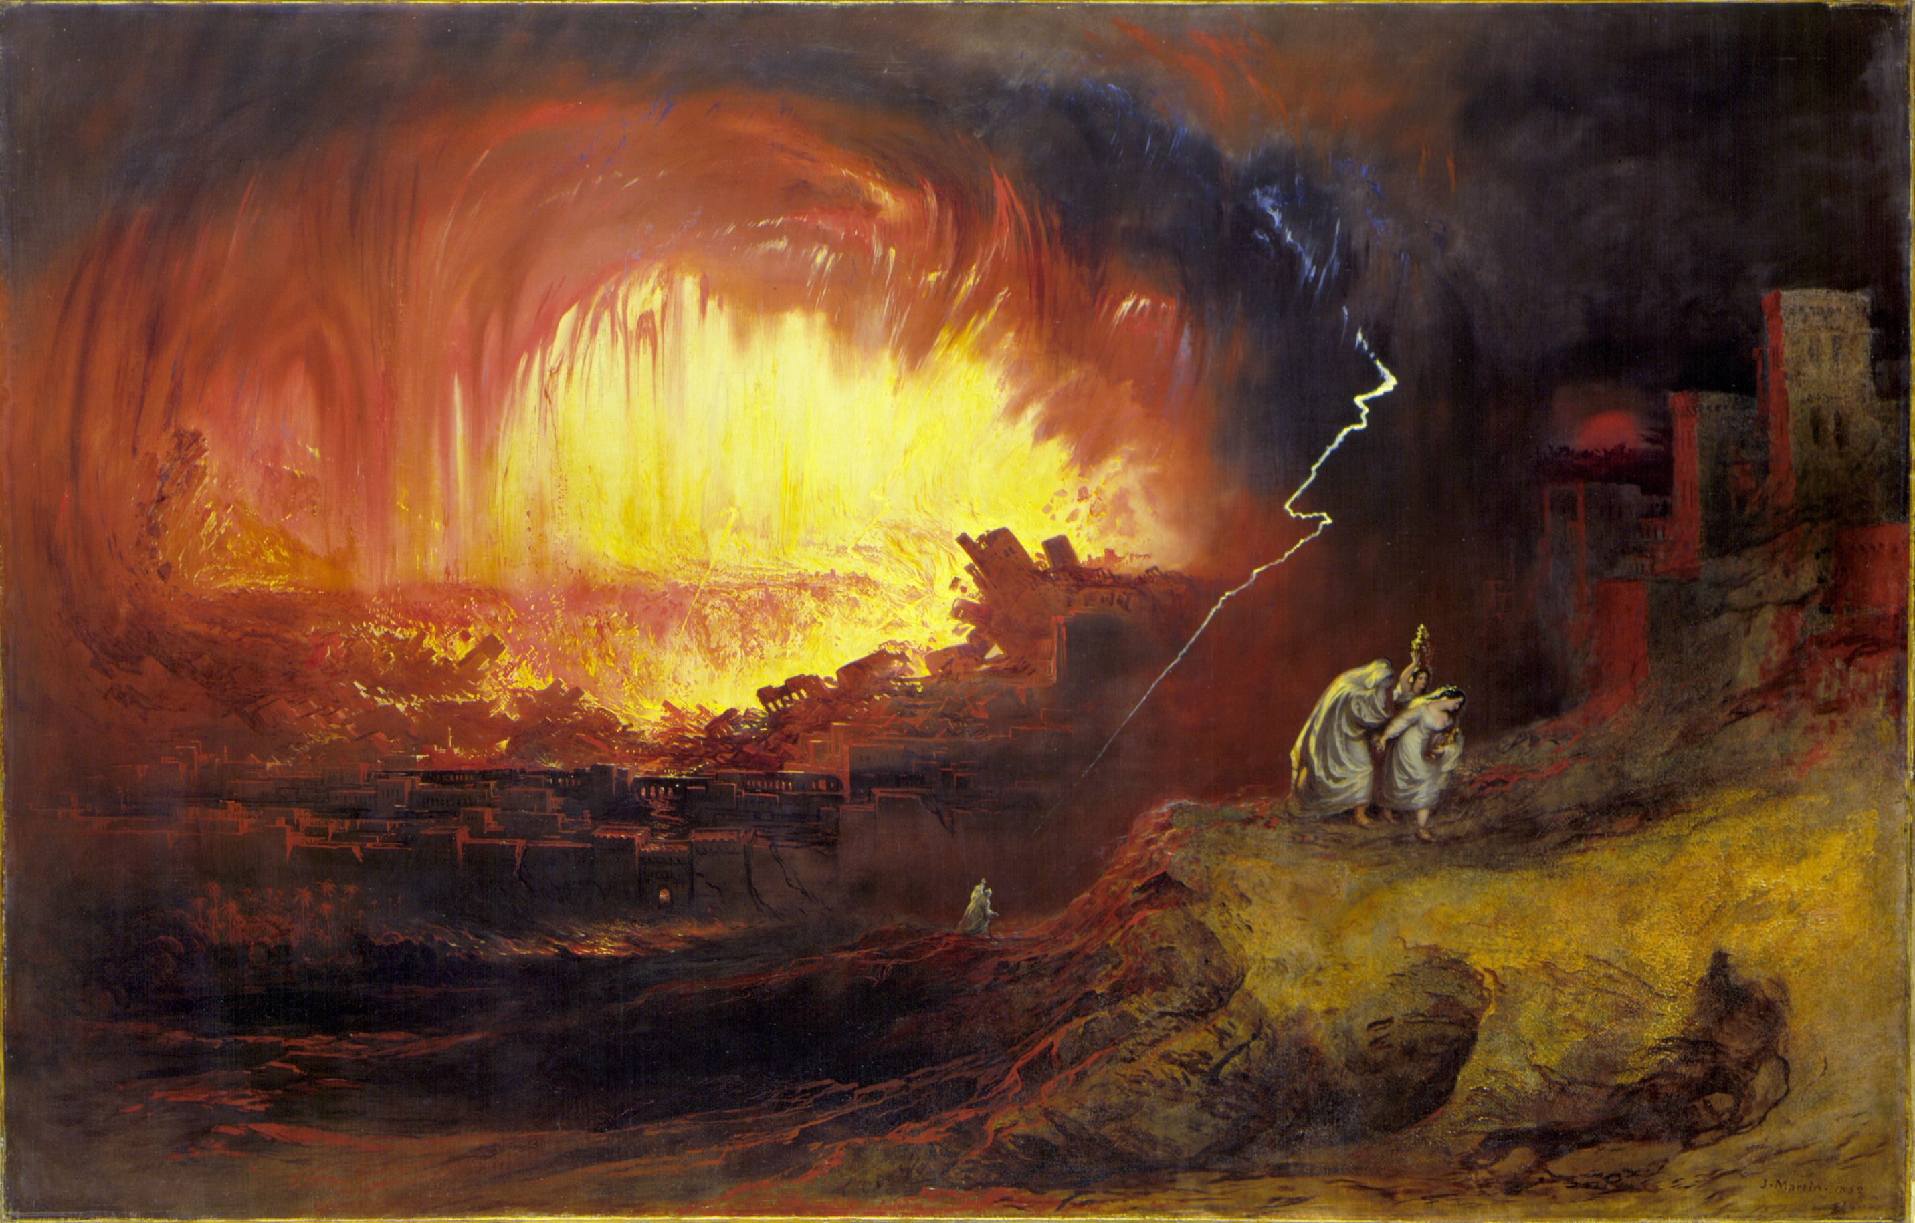
John Martin, The destruction of Sodom & Gomorrah, 1852,
Oil on canvas, Laing Art Gallery, Newcastle upon Tyne

Slide 16
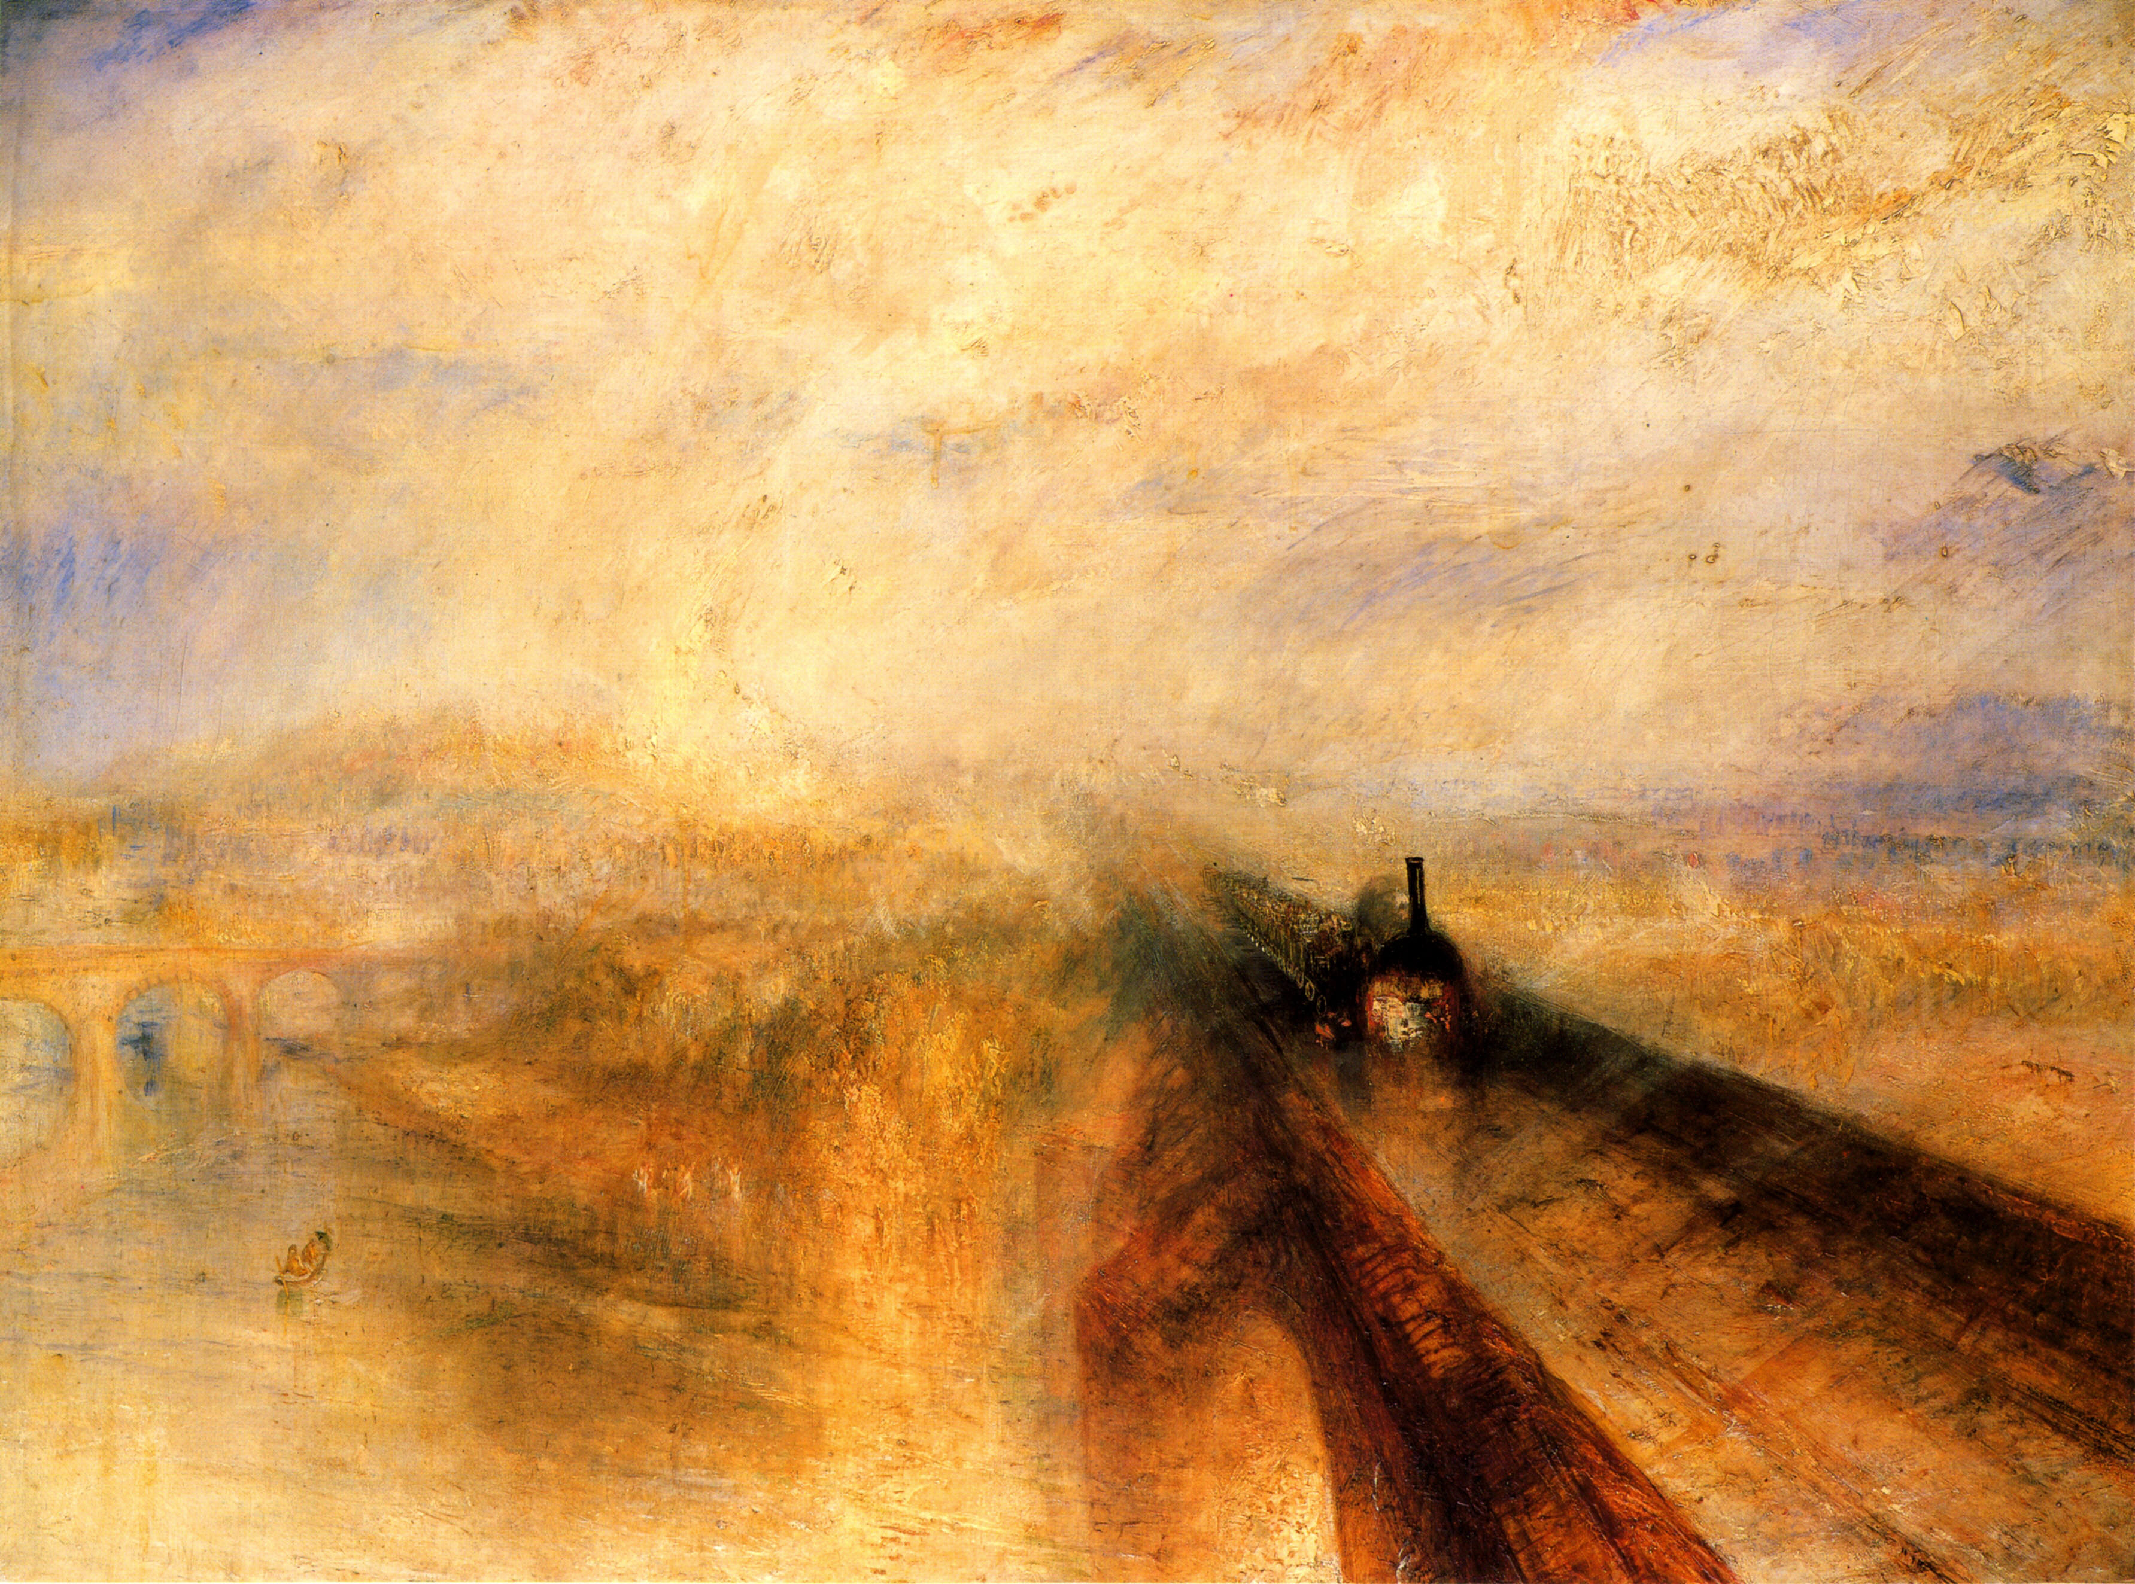
William Turner, Rain, Steam & Speed, alias GWR, 1844
Oil on canvas, 91 x 121 cm, National Gallery, London

Slide 17
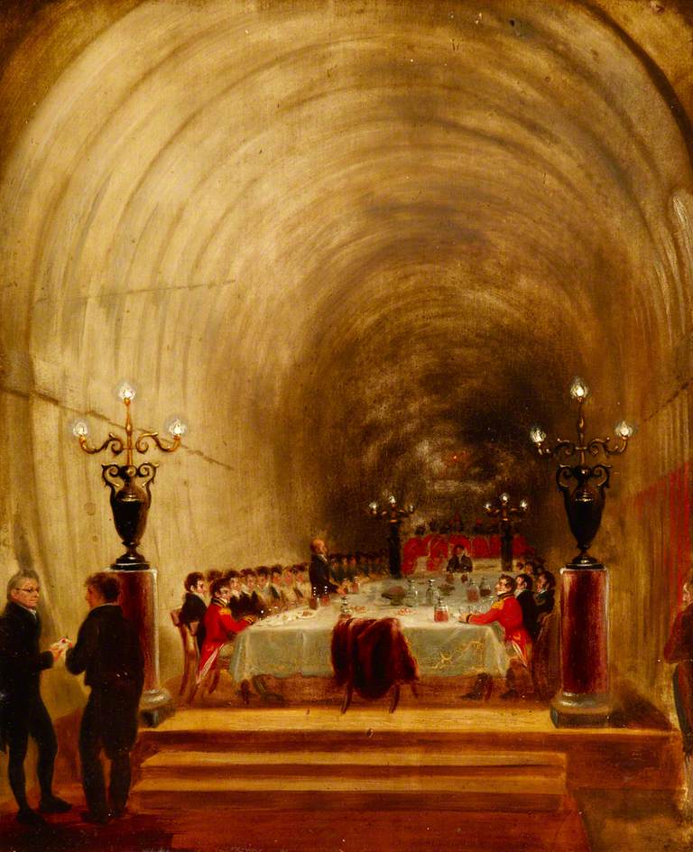
Banquet in the Thames tunnel, 1827
Artist unknown, oil on board from FD Klingender, 1968 page 211:
«To reassure the public & the shareholders it was decided to hold a dinner in the workings on 10 Nov. 1827. (…) A few weeks later the Tunnel was inundated & all work held up for many weary months while funds were raised with which to make a fresh start. »

Slide 18
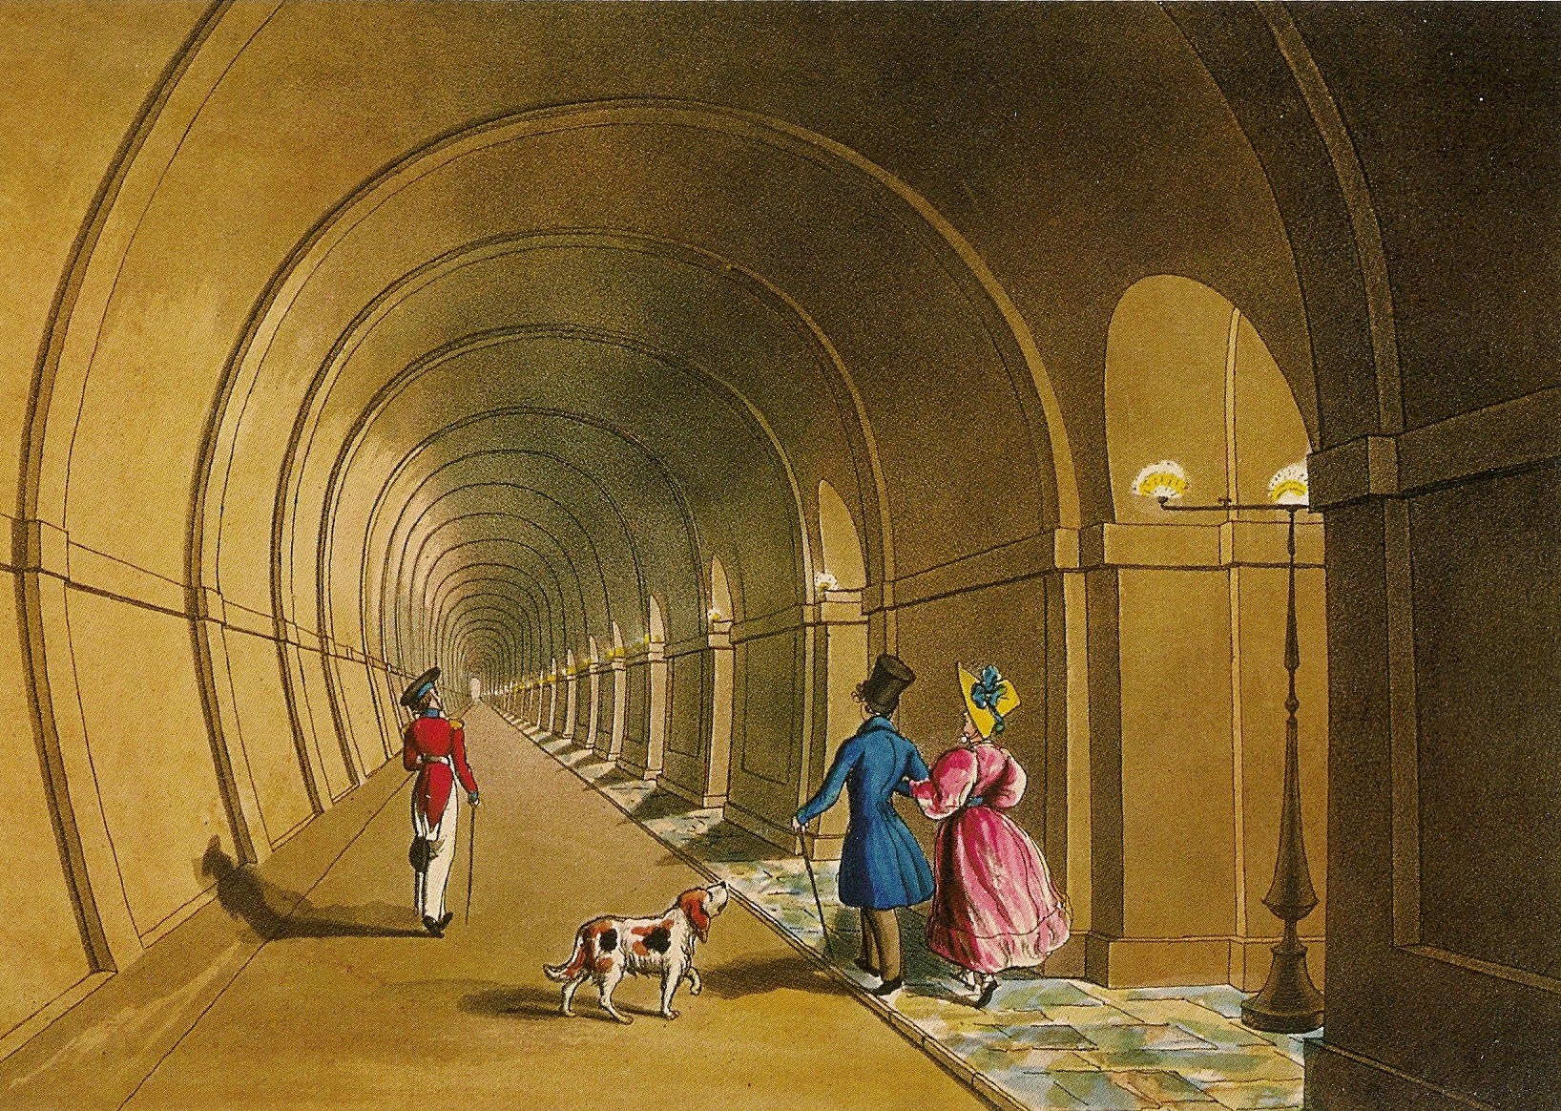
Thomas Talbot Bury (1811-1877) Thames Tunnel, 1835
Aquatint, from Mail Online, 13 March 2010

Slide 19
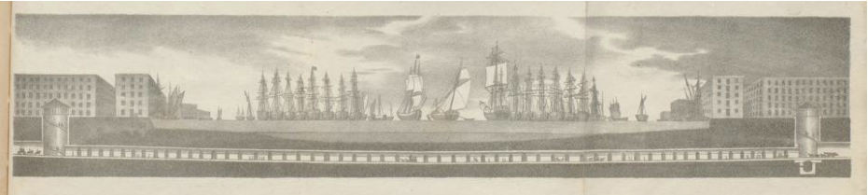
Thames Tunnel between Rotherhite and Wapping cross section of the project length 1 300 feet
Marc Isambard Brunel (1769-1849)
Zeichnungen und Notizen von der Arbeiten an dem Gange unter der Themse von Rotherhithe nach Wapping, London, G. Schulze, 1827

Slide 20
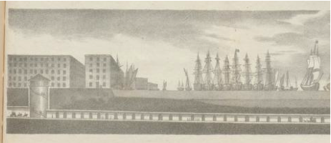
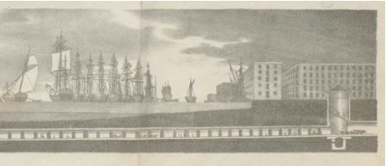
Thames Tunnel from Rotherhite to Wapping, project, 1.300 feet long from Marc Brunel’s Zeichnungen, 1827

Slide 21
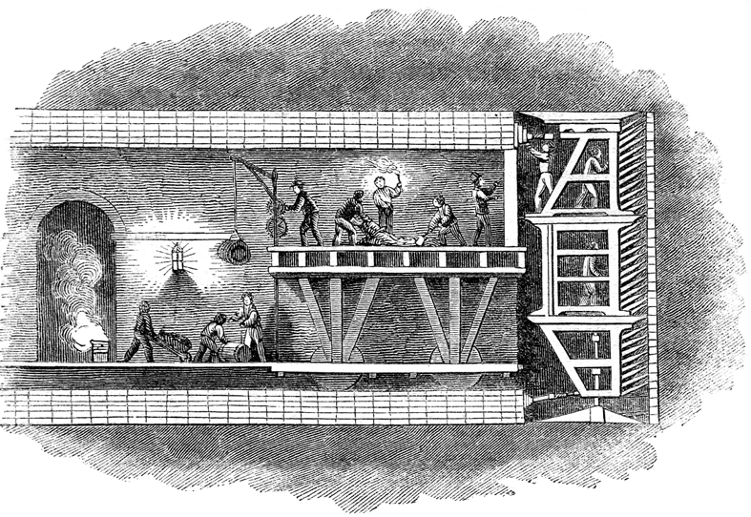
Marc Brunel′s system of tunnelling with the «shield» progressing in front of the brick vault
Xylograph, 1827 circa, from Wikipedia Thames Tunnel, 12 April 2014

Slide 22
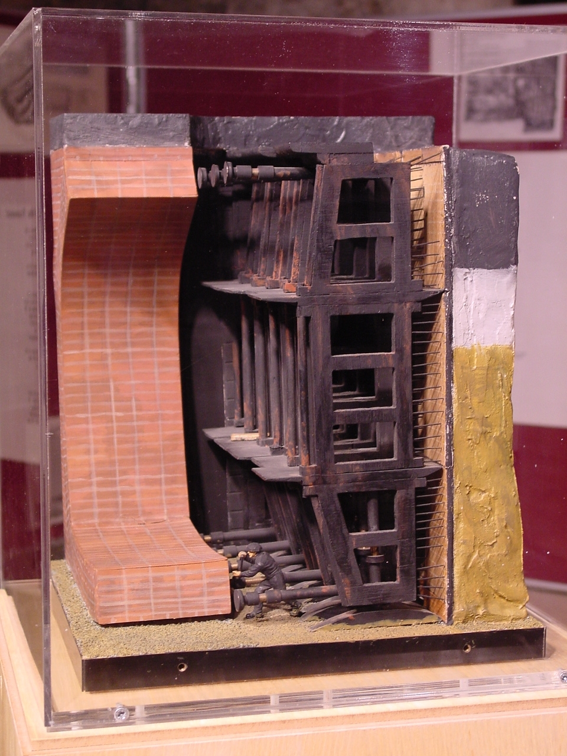
Marc Brunel & Thomas Cochrane tunnelling shield
Model at the Brunel Museum at Rotherhithe from Wikipedia Thames Tunnel
12 April 2014

Slide 23
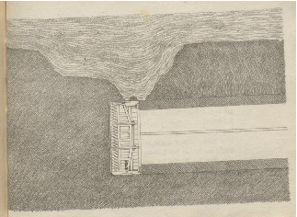
The excavating technique of «the shield» from Marc Brunel’s Zeichnungen, 1827

Slide 24
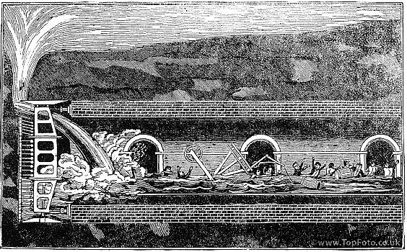
Thames Tunnel, 1st flood, 1827, xylograph from Wikipedia, Thames Tunnel, 12 April 2014

Slide 25
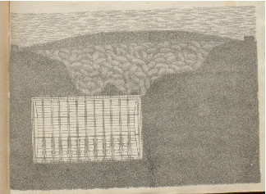
Restauration of the brick vault in 1827 by Isambard Kingdom Brunel from Marc Brunel’s Zeichnungen, 1827

Slide 26
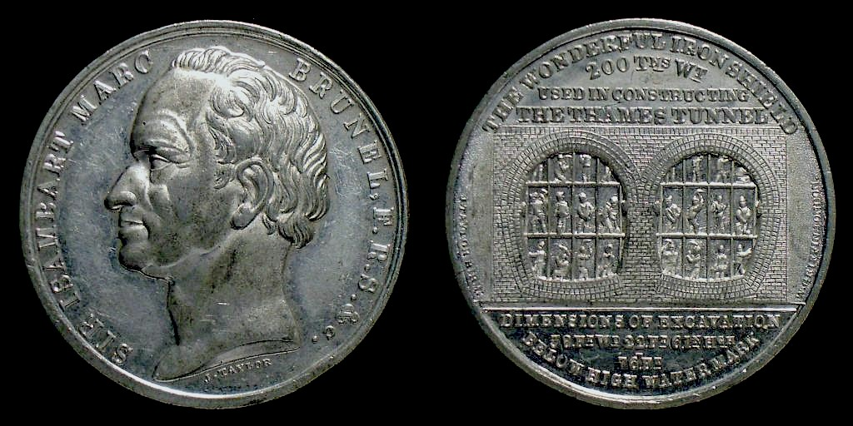
Sir Isambart Marc Brunel’s Medal coined by J. Taylor, ca. 1848
The Wonderful Iron Shield used in Constructing the Thames Tunnel, 200 Tns Wt
Dimensions of Excavation below High Water Mark

Slide 27
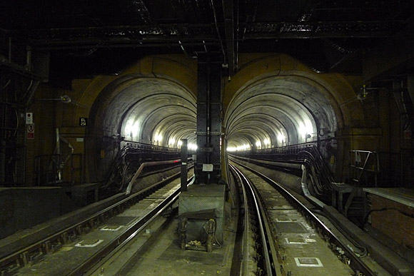
Marc & Isambard Brunel′s Thames tunnel in its present function
Picture by Urban 75, 12th March 2010

Slide 28
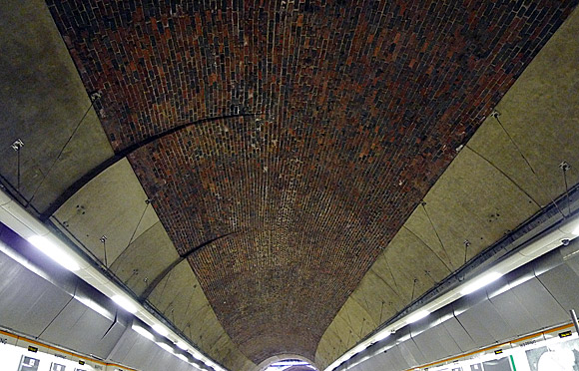
The brick vault
Marc & Isambard Brunel′s Thames tunnel in its present function
Picture by Urban 75, 12th March 2010

Slide 29
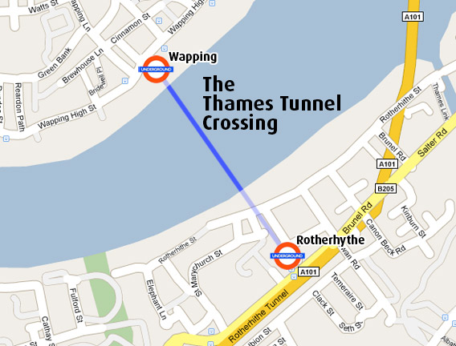
East London Line

Slide 30
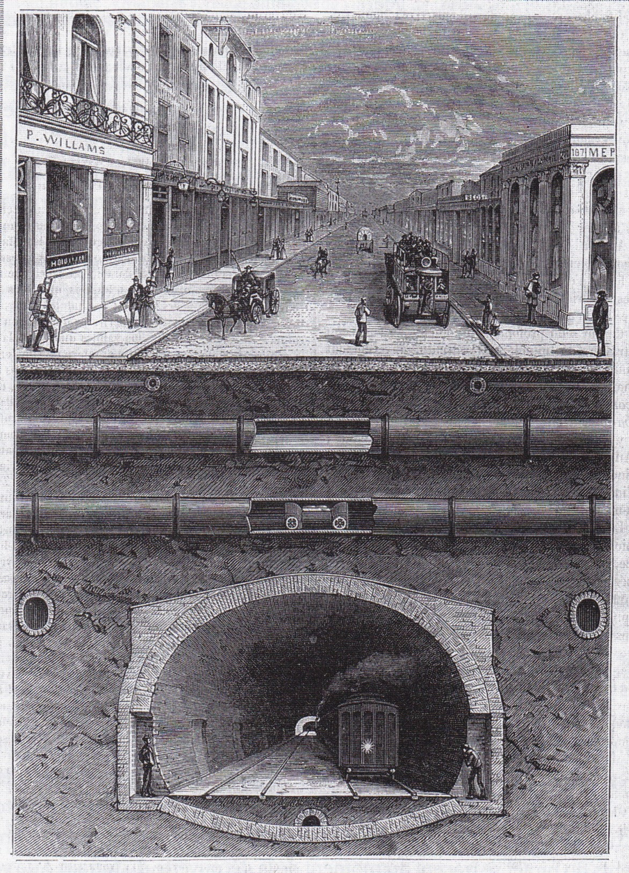
Ce qu′il y a sous le pavé de Londres alias
What do you find under the streets of London heliograph from Gaston Tissandier, La Nature, Revue des Sciences et de leur application aux Arts & à l‘Industrie,
1884, vol. II from Louis Figuier, Grands Tunnels & Railways métropolitains, Paris, Marpon & Flammarion, 1884

Slide 31
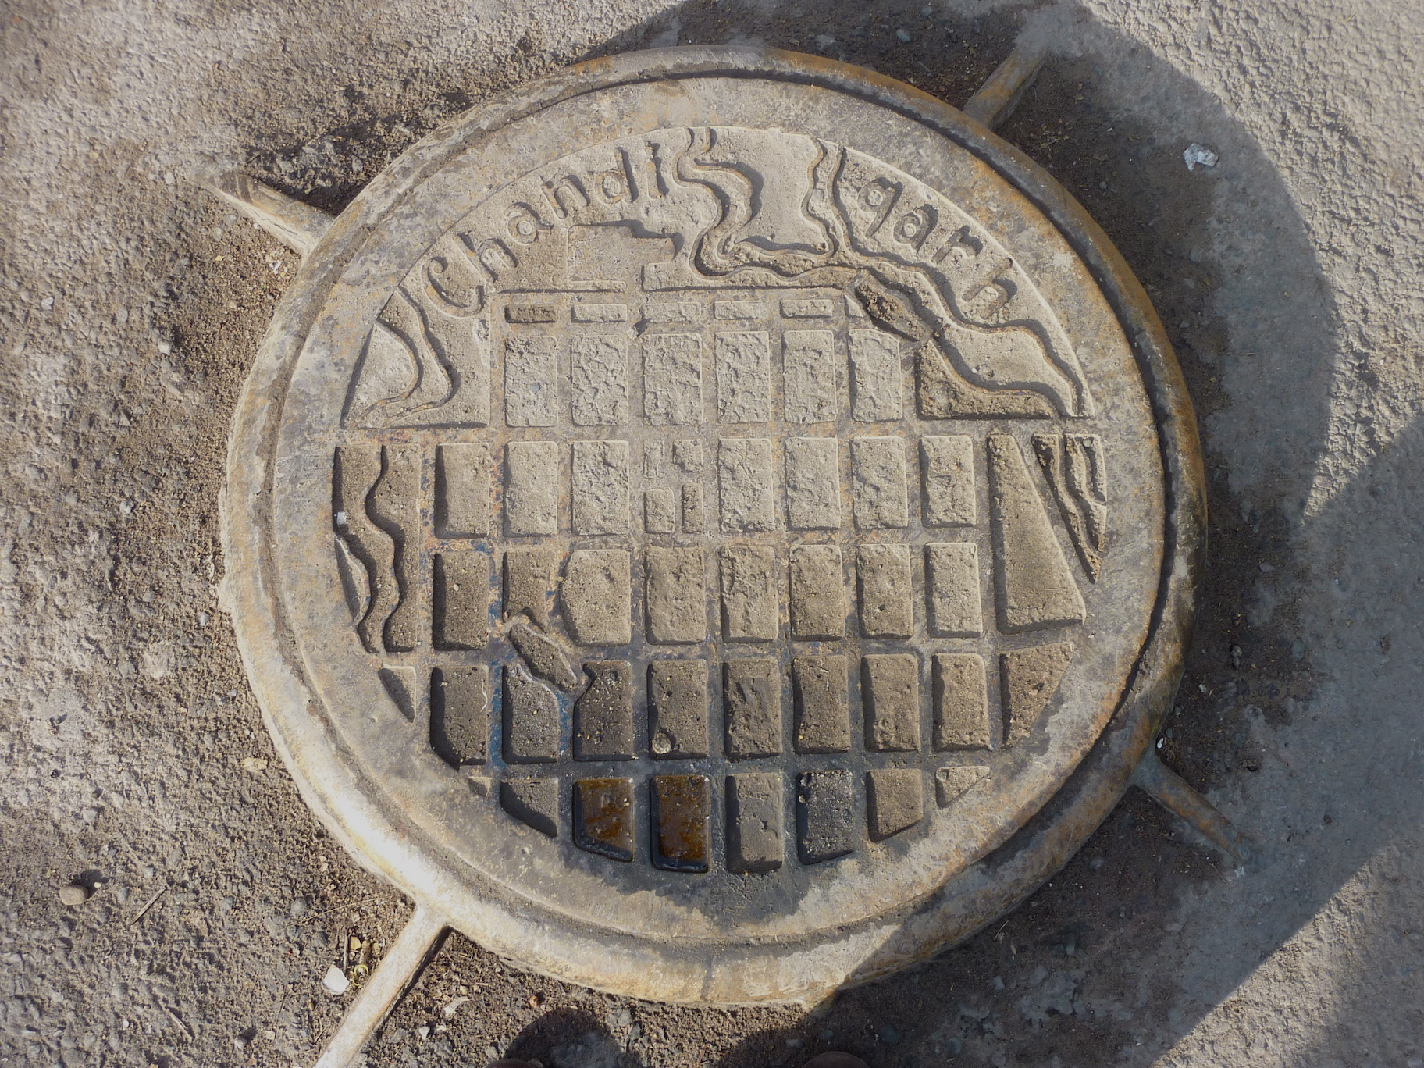
City of Chandigarh
Manhole, cast iron, design by Pierre Jeanneret, 1960 circa
Photo Edmond Charrière, February 2011

Slide 32
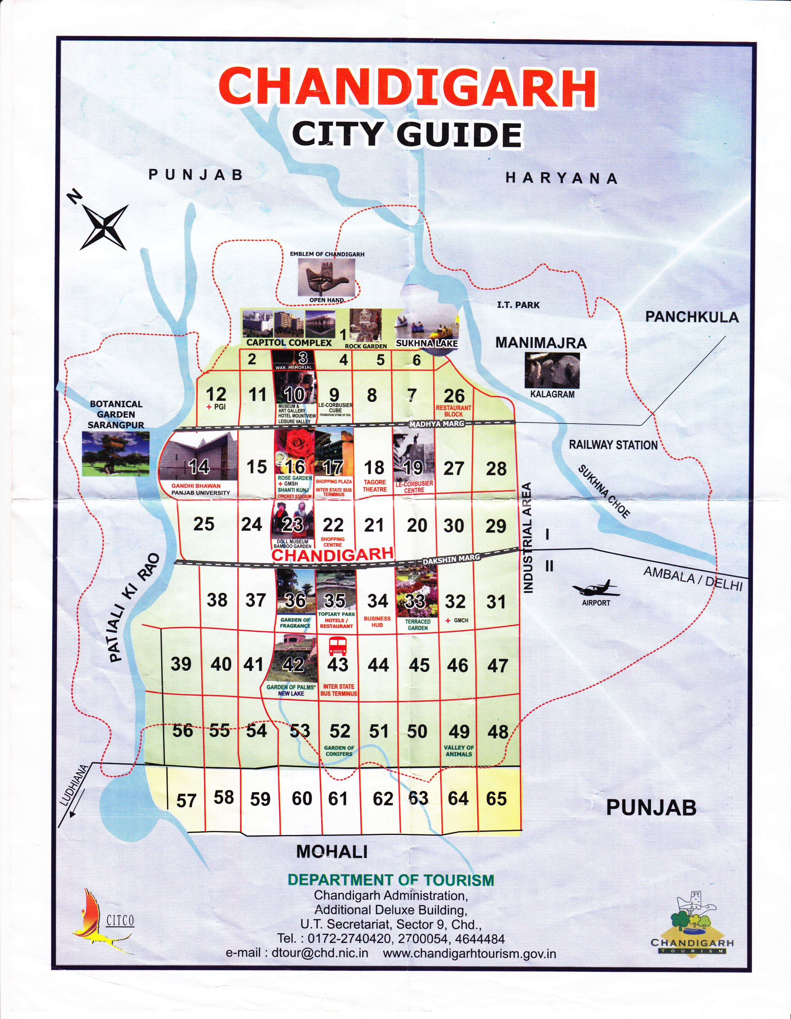
Department of Tourism
Chandigarh Administration
2010

Slide 33
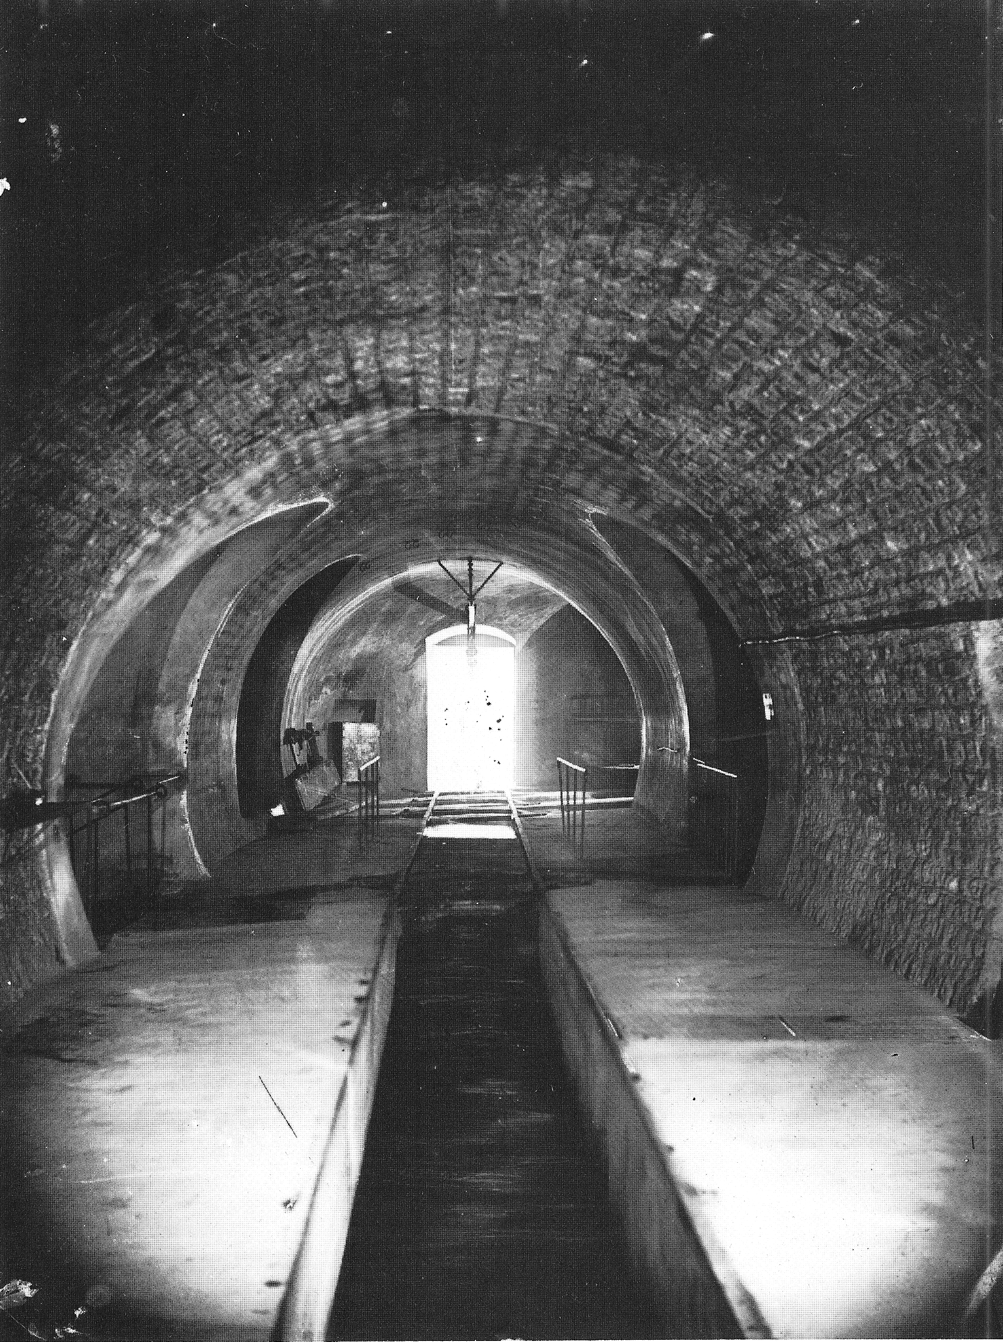
Félix Tournachon alias
Nadar (1820-1910)
Paris’ sewer photograph under phosphorescent light
1861 circa from Wikimedia Commons
Les égouts de Paris
2 jan. 2013

Slide 34
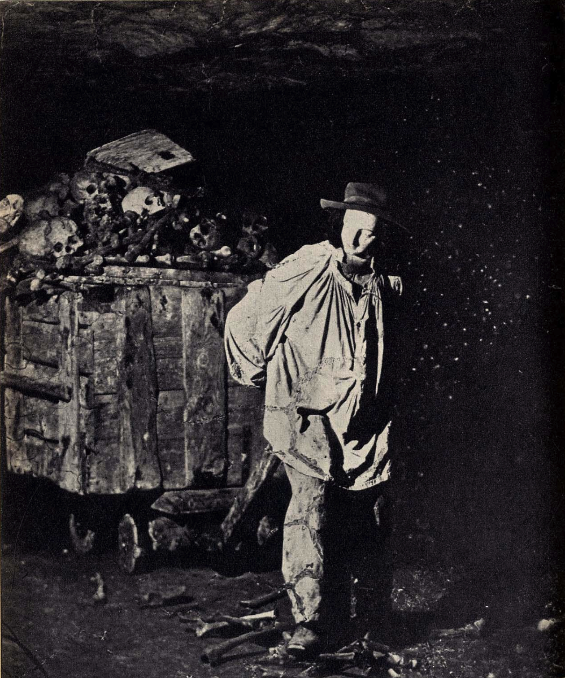
Félix Tournachon alias
Nadar (1820-1910)
Paris’ catacombs photograph under phosphorescent light
1861 circa from Wikimedia Commons
Les catacombes de Paris
2 jan. 2013

Slide 35
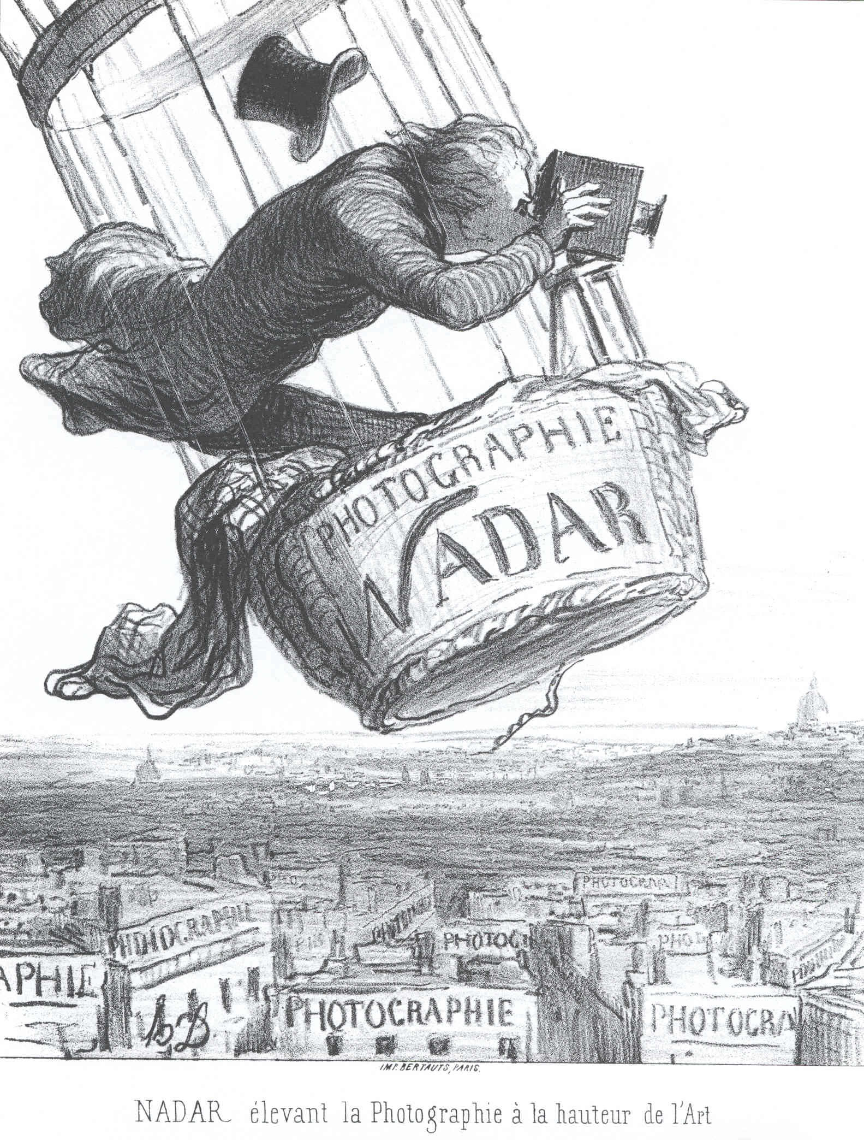
Honoré Daumier (1808-1879)
Lithograph
25 May 1862 in Le Boulevard
Google Images
26 Sept 2012

Slide 36
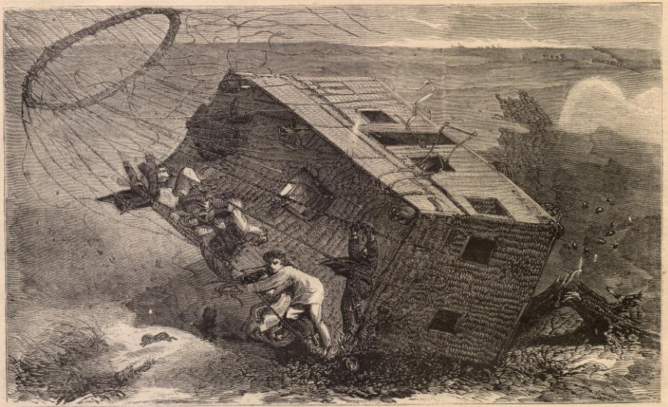
Crash of the balloon Le Géant the eighteen of October 1863 at Nieubourg near Hannover
Xylograph by Henry de Montaut
Unknown magazine from Online Collection, Brooklyn Museum, 2004

Slide 37
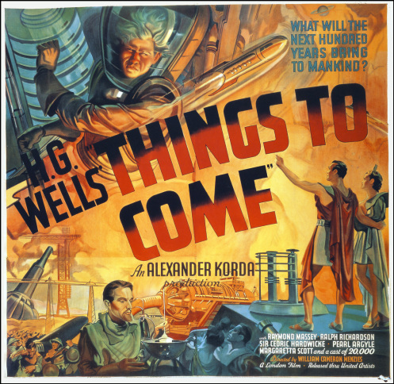
Things to Come,
W.C. Menzies director
H.G. Wells script
Korda producer
London Films
Productions
February 1936

Slide 38
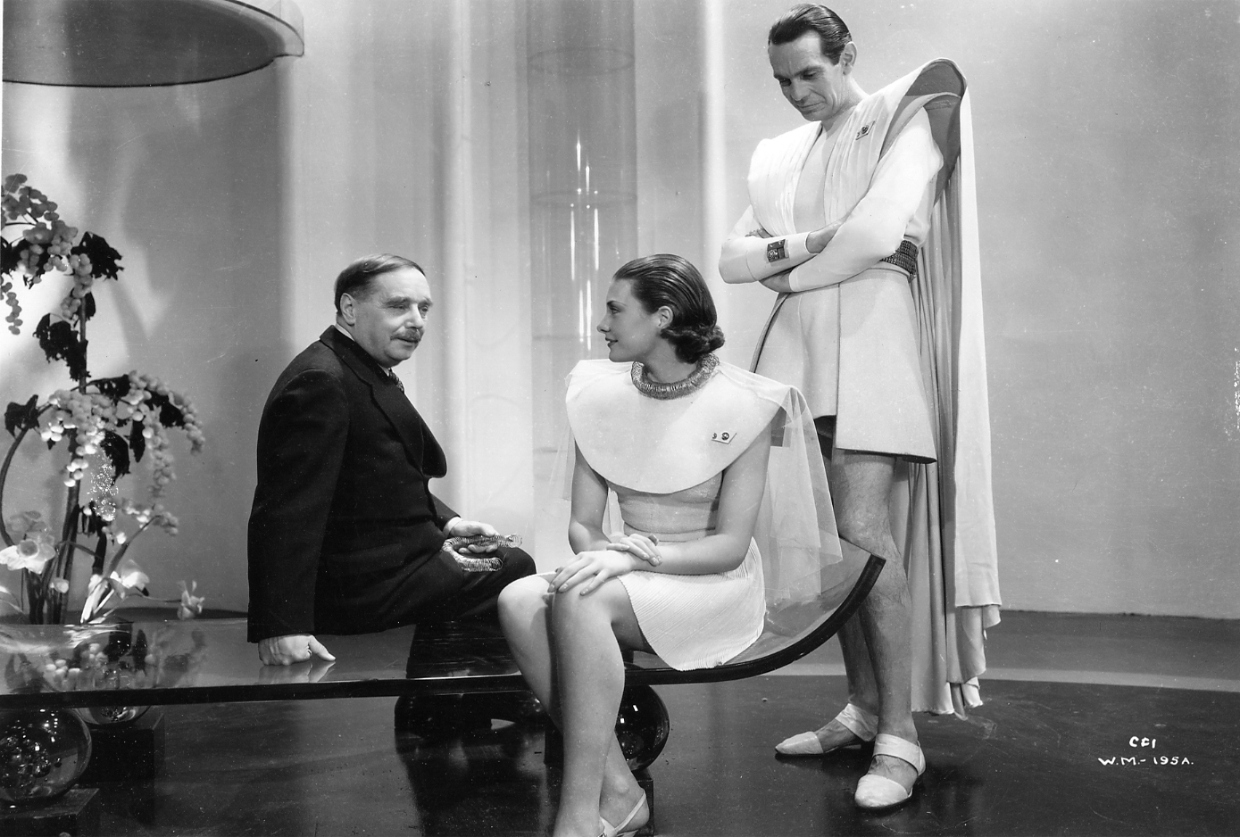
What will the next 100 years bring to mankind ?
H.G. Wells with Pearl Argyle on the set of Things to Come, London 1936

Slide 39
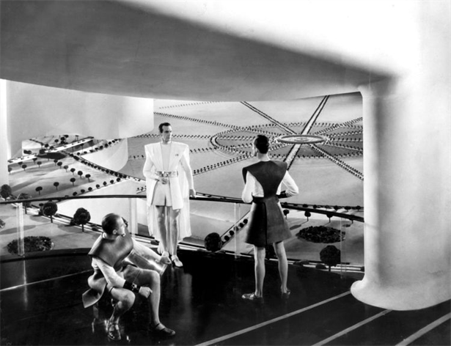
The town of Everytown in 2036

Slide 40
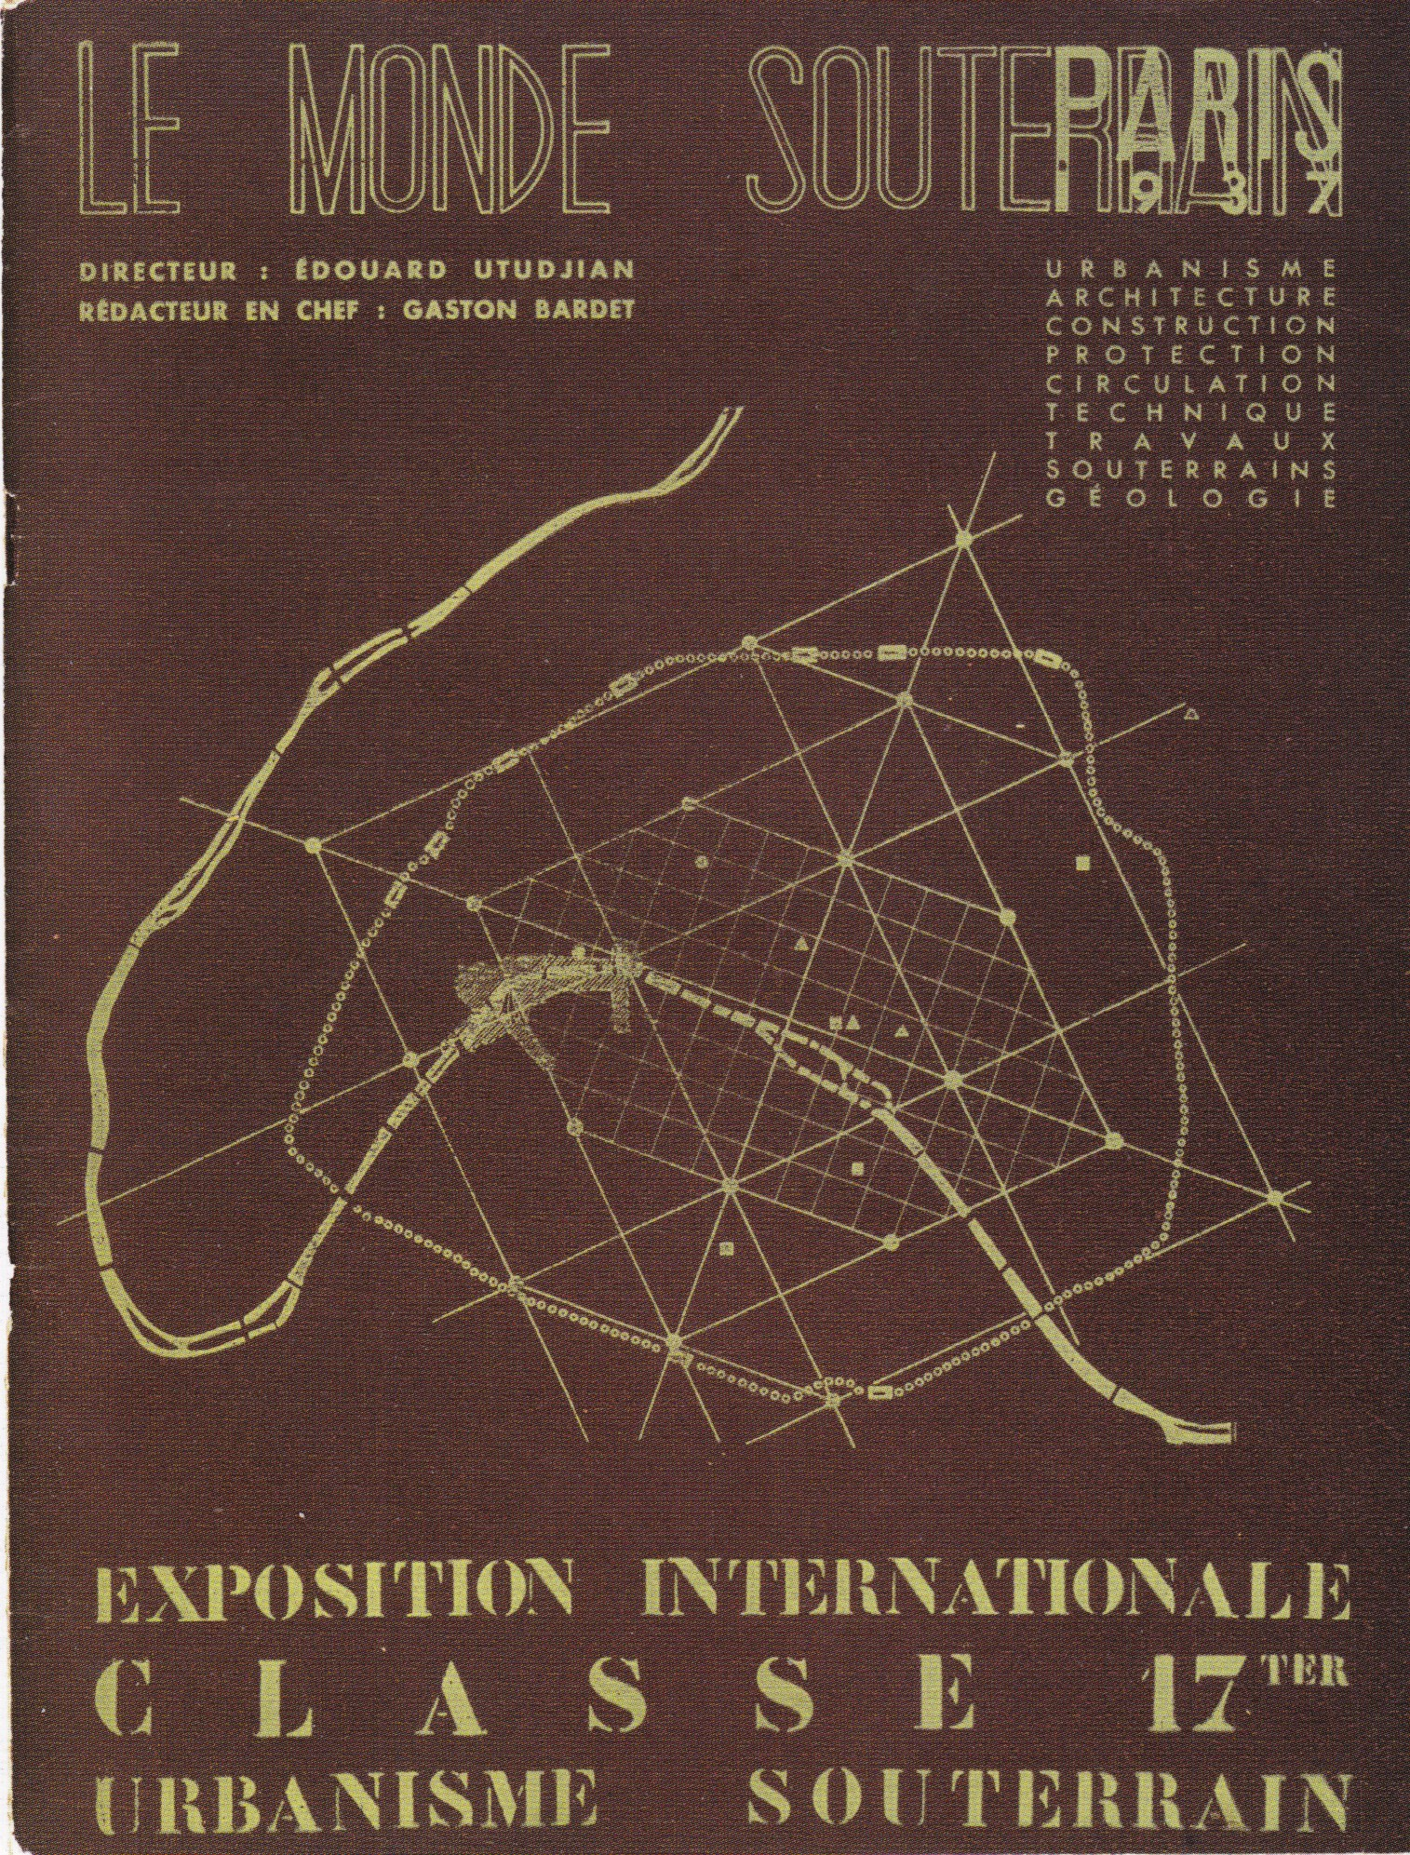
Edouard Utudjian
Gaston Bardet
Jean Tschumi
Special Issue of
Le Monde Souterrain
Paris World Exhibition
Arts & Techniques
1937
Section 17 ter
Urbanisme souterrain

Slide 41
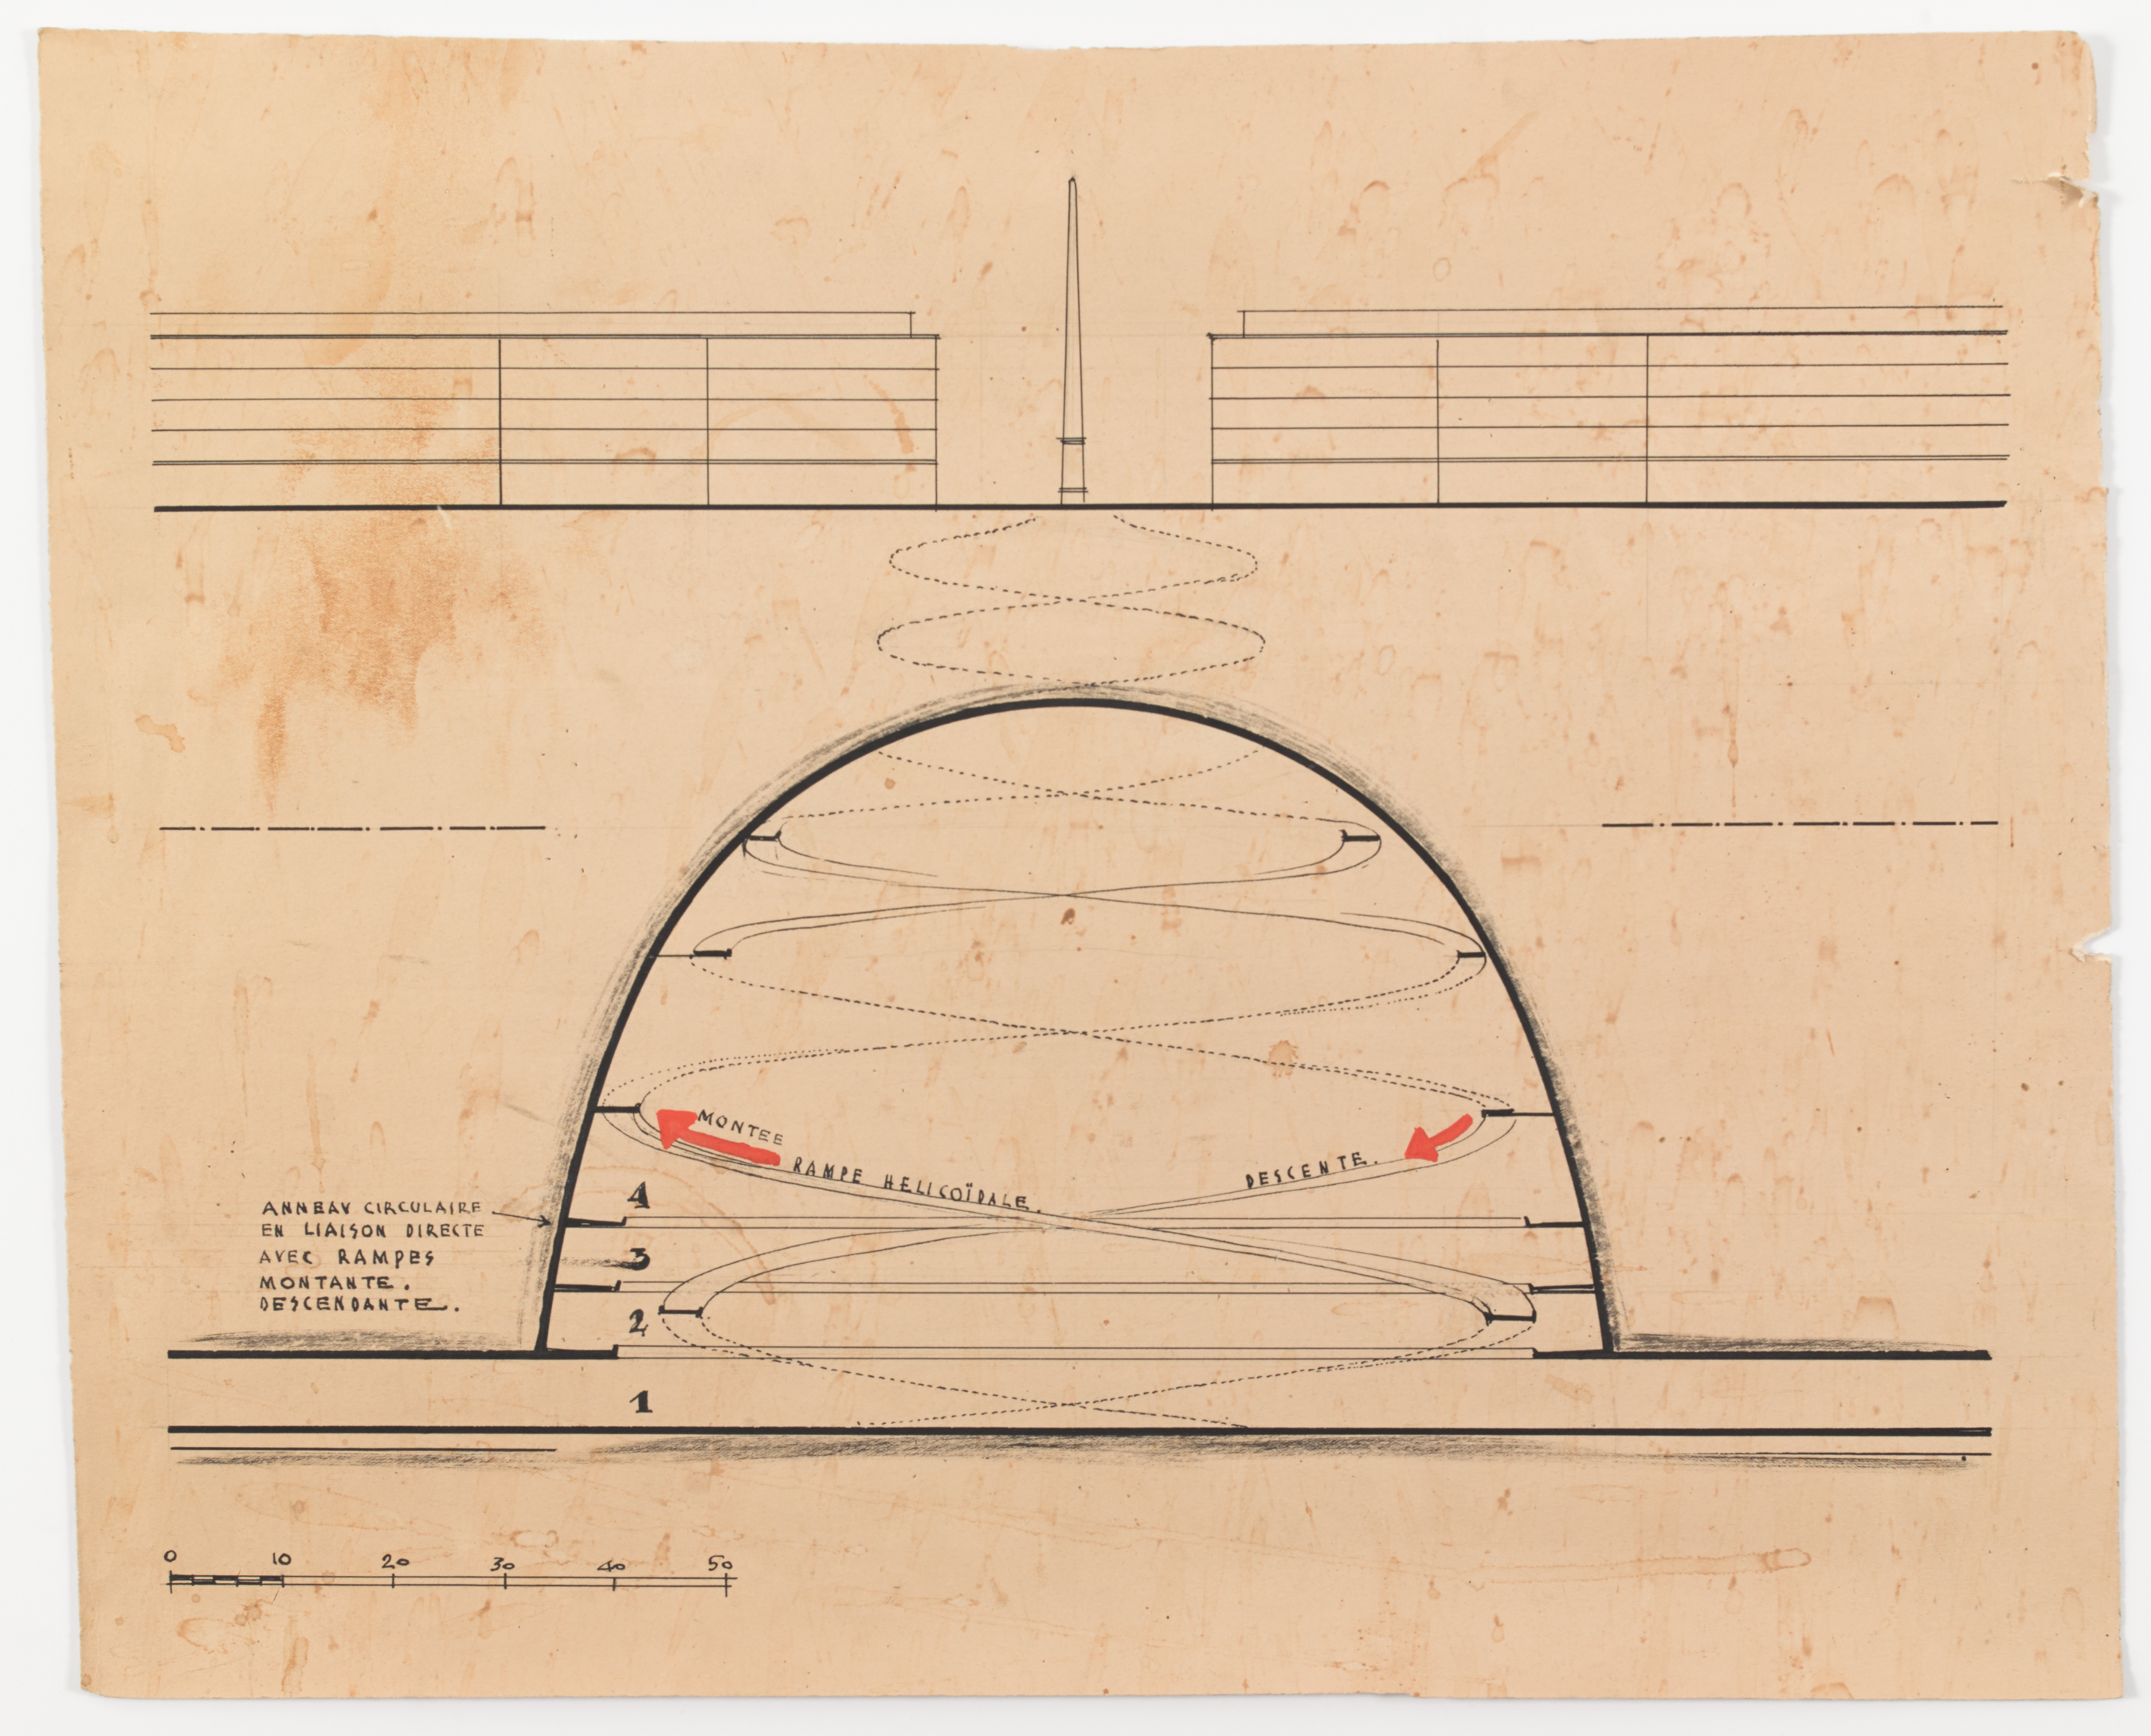
Jean Tschumi
Paris Souterrain
Section on the circular ring of the underground garage
1937

Slide 42
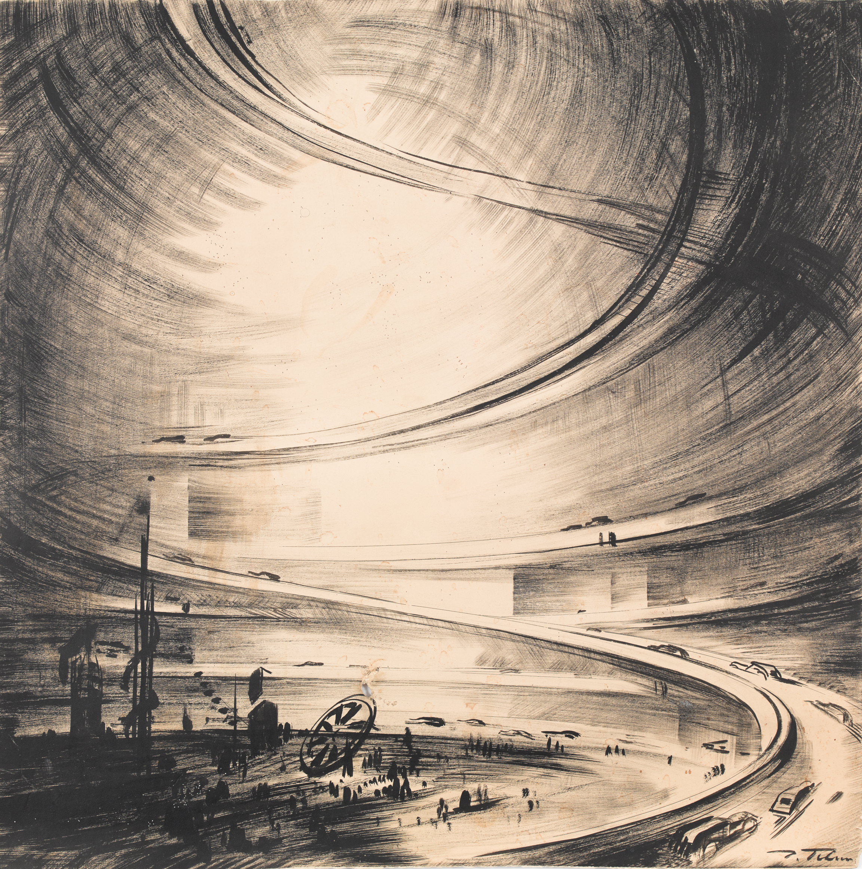
Jean Tschumi
Paris Souterrain
Circular ring underground garage in perspective
1937

Slide 43
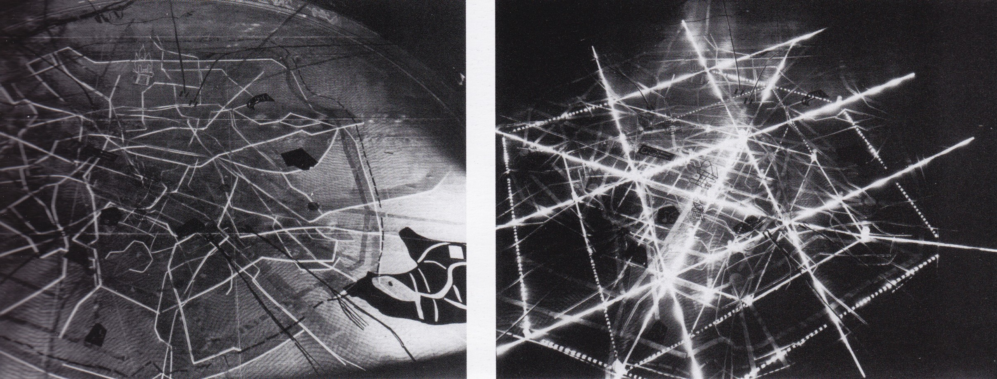
Jean Tchumi
Diorama of Paris Souterrain, a montage of wood, wire, paper & neon tubes
Paris, World Exposition Arts & Techniques, 1937

Slide 44
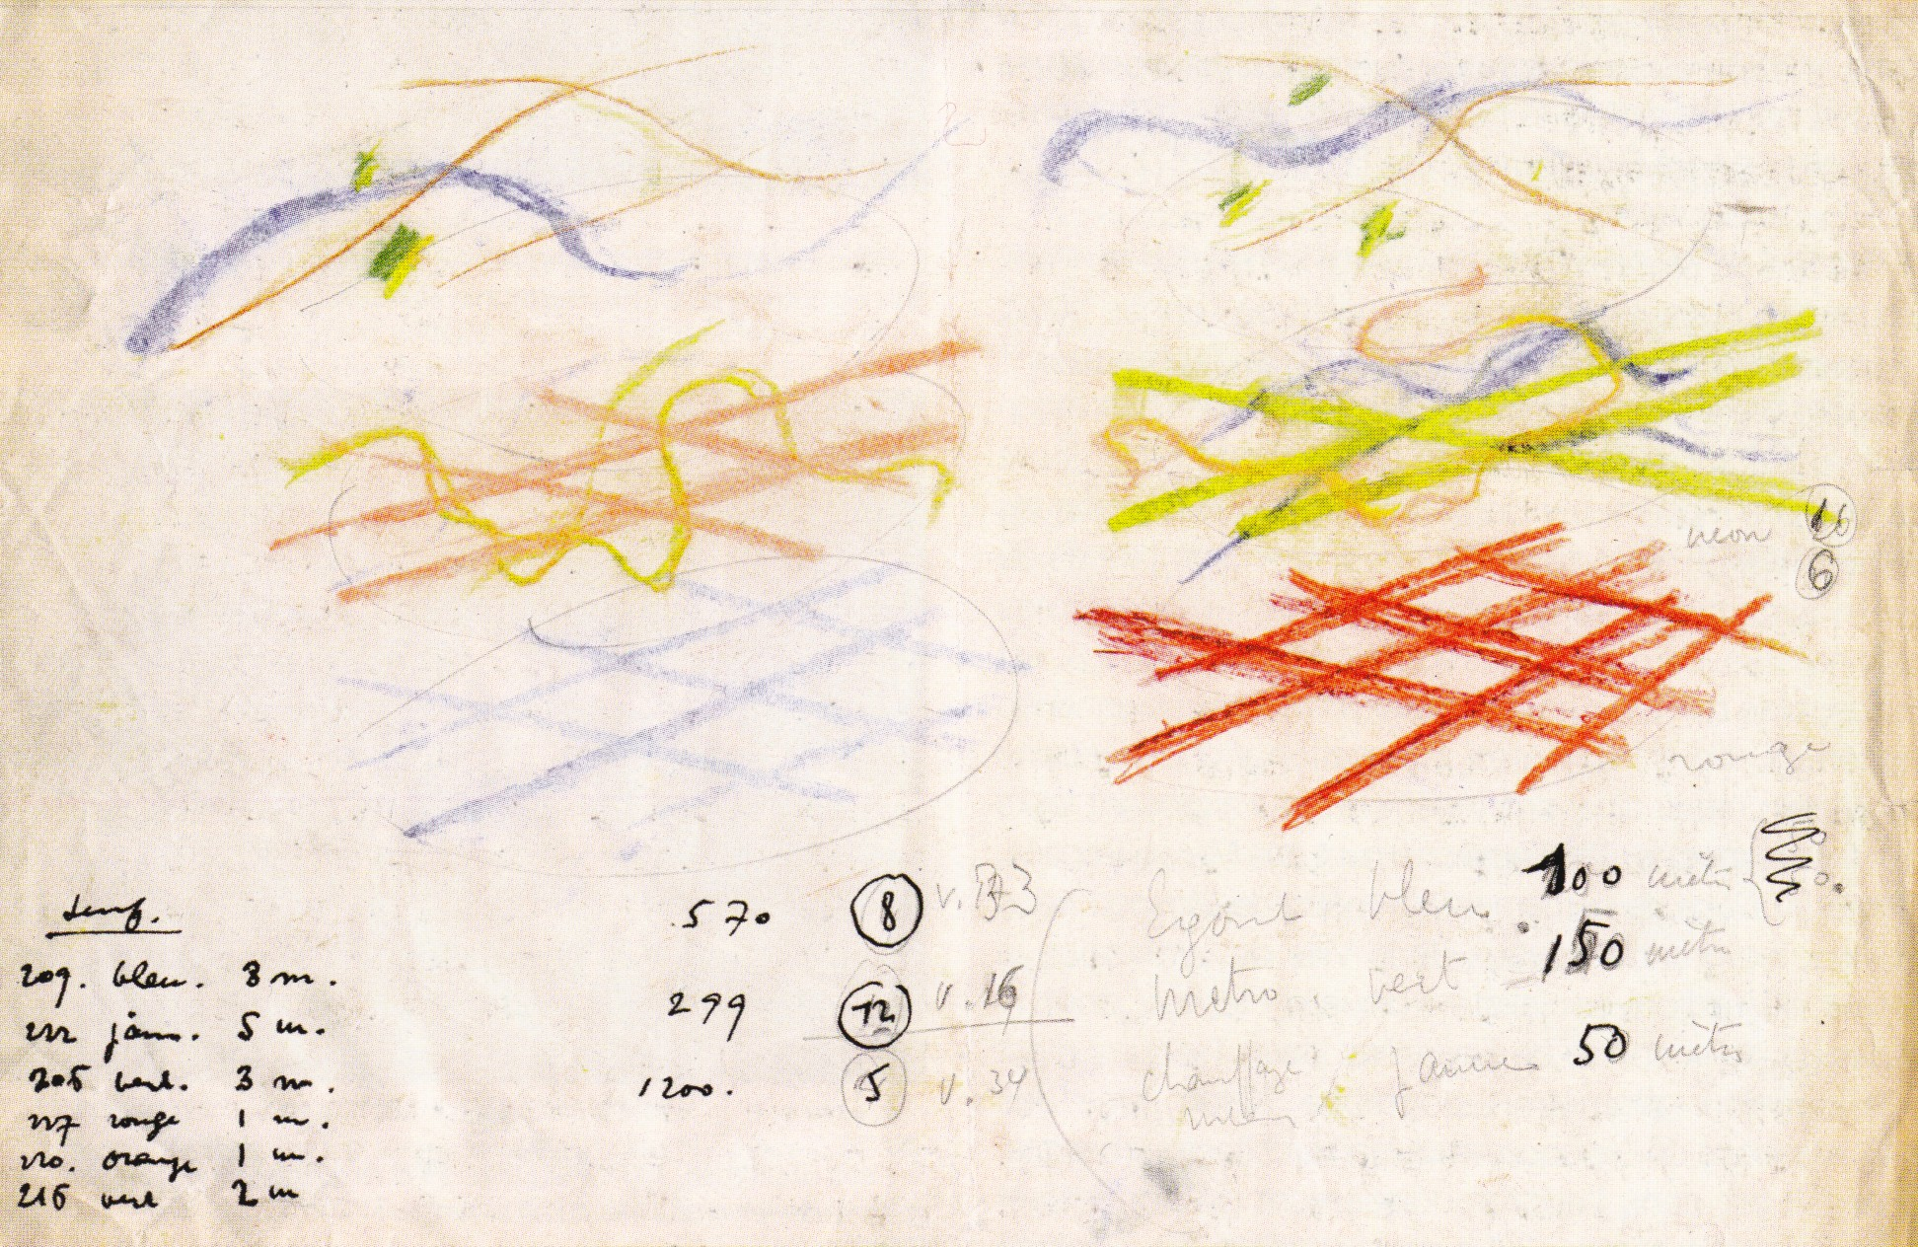
Jean Tschumi
Paris Souterrain, 1937
Study for the colour set of the neon tubes
Archives Acm, EPF-L

Slide 45
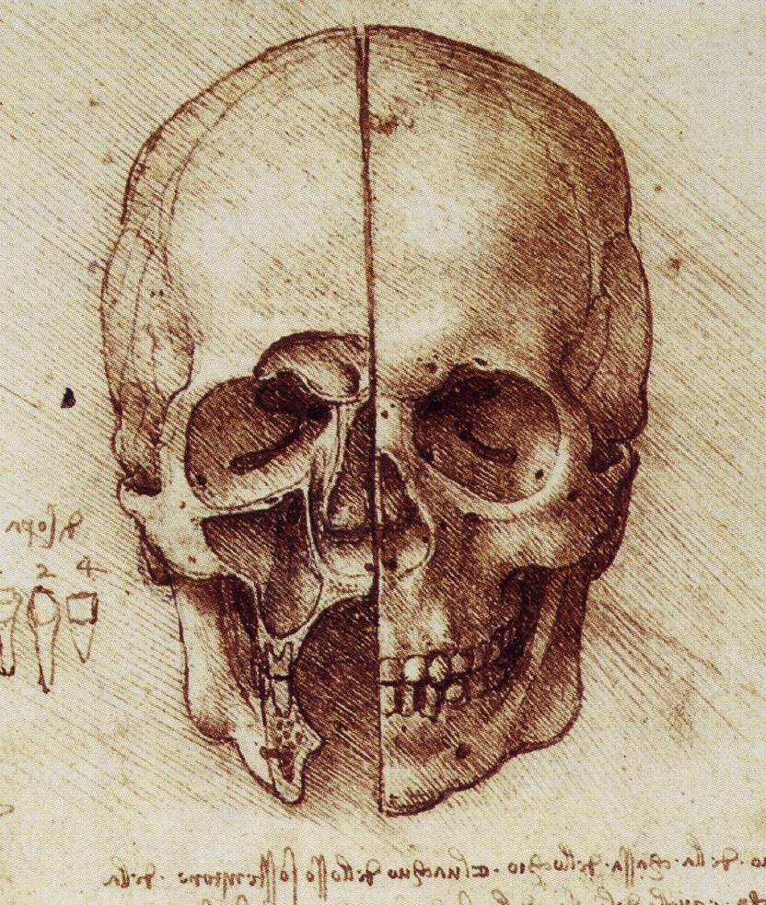
Leonardo da Vinci (1452-1519)
A scull sectioned circa 1489
Windsor Castle
Royal Library

Slide 46
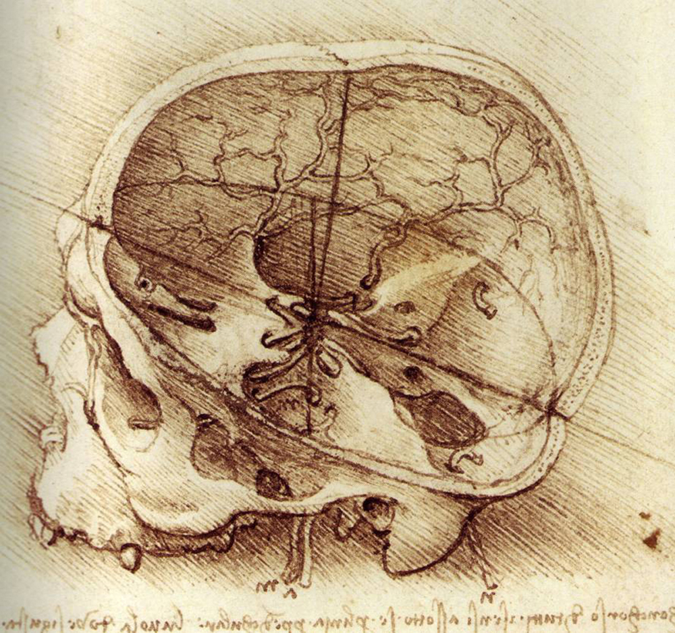
Leonardo da Vinci (1452-1519)
Study of a skull, circa 1489, Windsor Castle, Royal Library

Slide 47
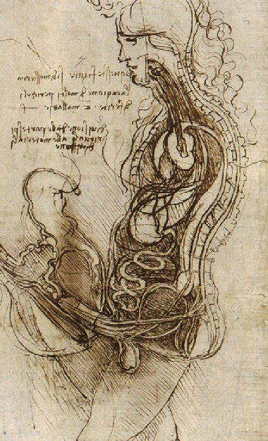
Leonardo da Vinci (1452-1519)
Figures in coition
1493 circa
Courtesy of Her Majesty Queen Elisabeth II

Slide 48
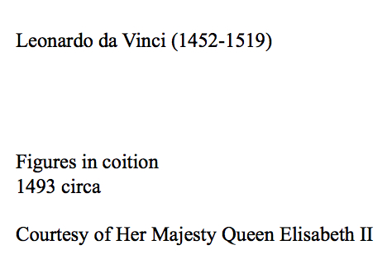

Slide 49
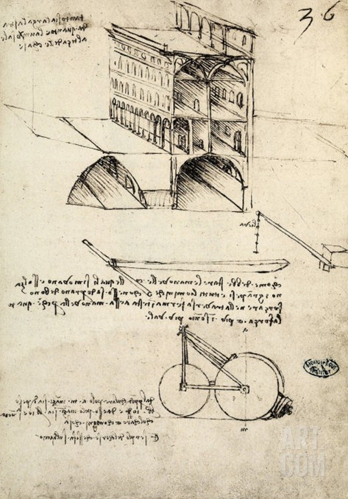
Leonardo da Vinci (1452-1519)
1490 circa
Città ideale
1490 circa
Paris, Institut de France

Slide 50
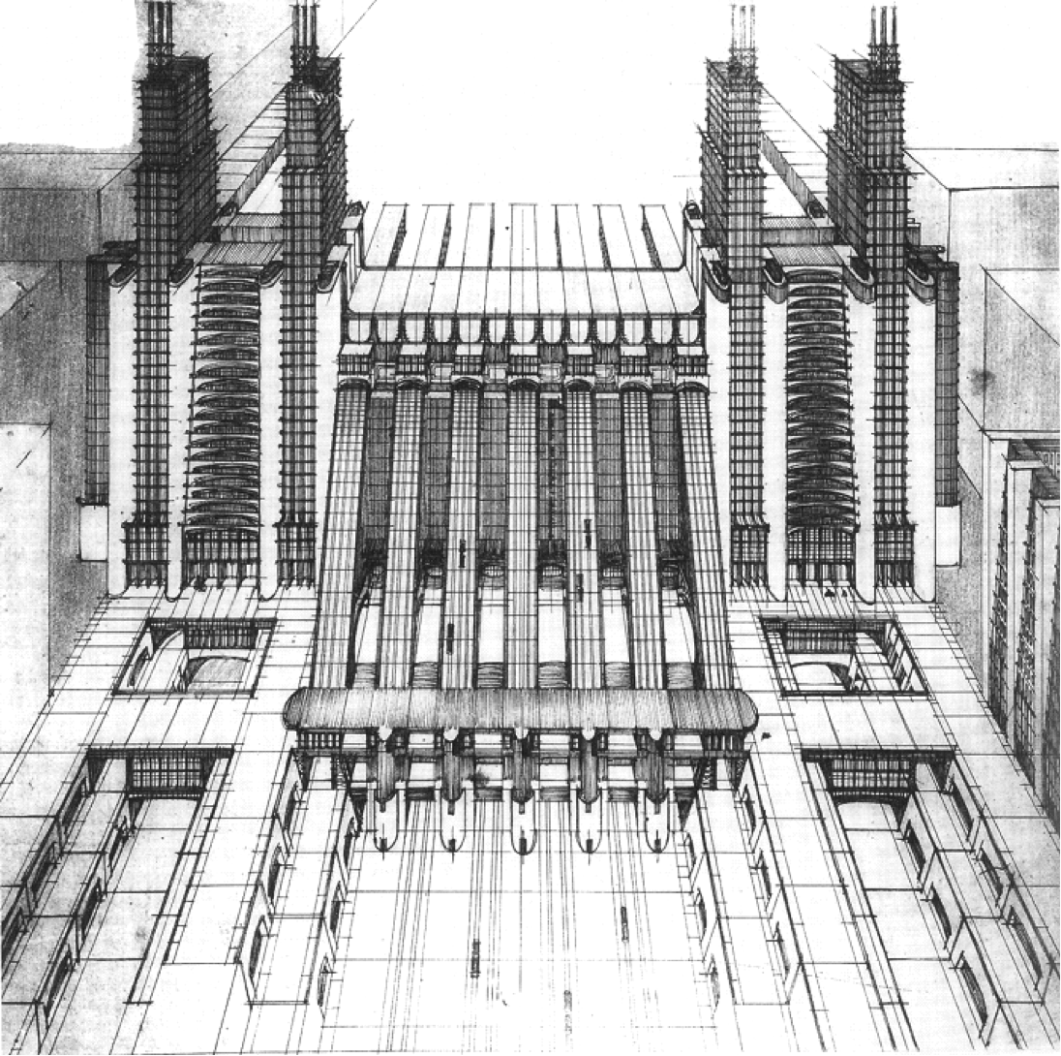
Antonio Sant’Elia
1888-1916
Stazione d’aeroplani e treni con funicolari e ascensori su tre piani stradali
Ink on tracing paper
50 x 39 cm
Como
Pinacoteca Civica

Slide 51
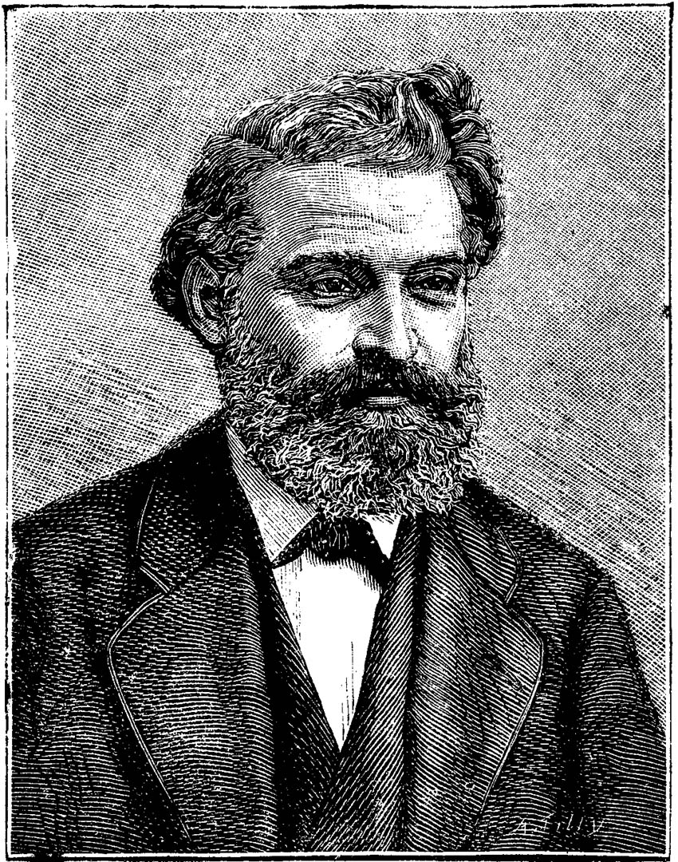
Louis Favre
1826-1879
Contractor of the
Gotthard Tunnel
Xylograph wikimedia org

Slide 52
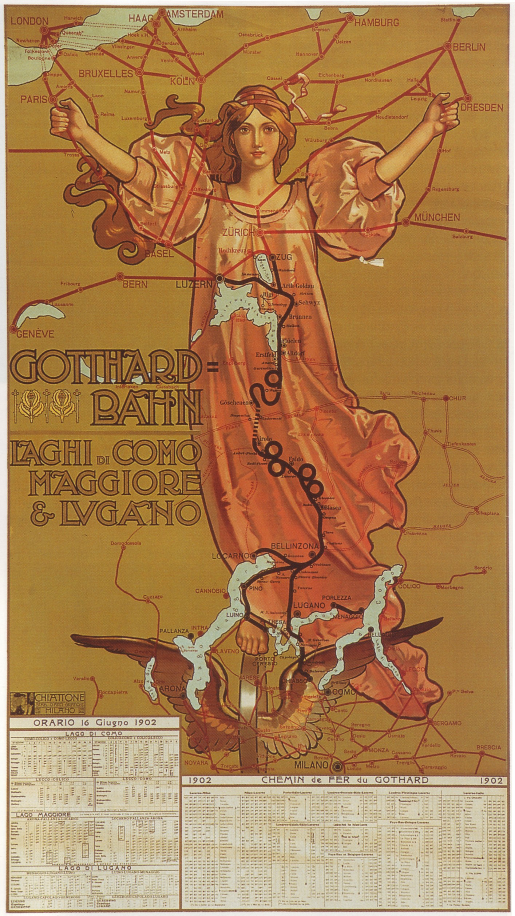
Time table of the Gotthard Railway Company
Lithograph
June 1902
Stabilimento Arti grafiche Chiattone
Milano
SBB Archive, Bern

Slide 53
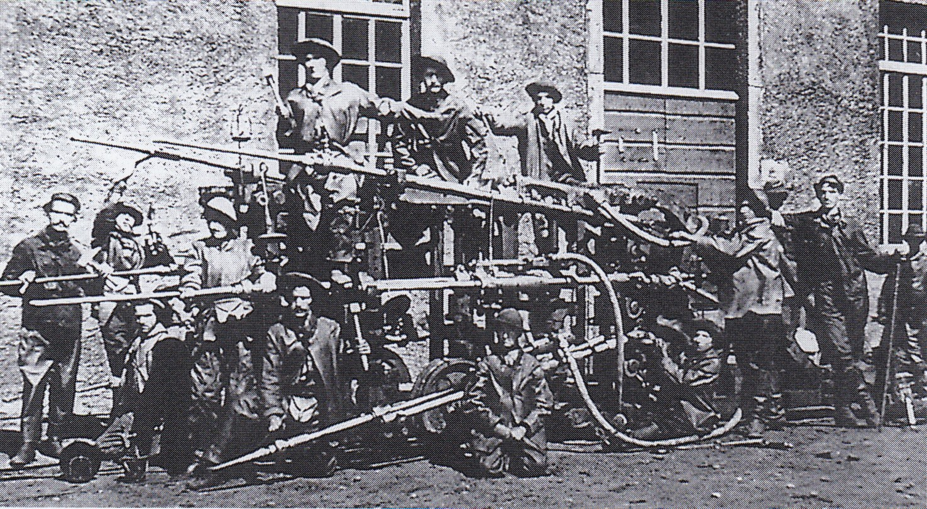

Camille Ferroux pneumatic drill anon. photographer
1875 circa
& its xylographic translation from
Aurelio Galfetti & al.
Progetto & territorio
Gli assi di transito & trasformazioni (…) del
Cantone TI
Accademia USI 2001

Slide 54

Louis Favre (1826 -1879) Tunnel du Gothard, sections normales de percement, 1° Galerie de direction, 2° Abbatages, 3° Cunette
From www Alpen Tunnel.de
5 May 2014

Slide 55

Louis Favre (1826-1879)Cunette du (illisible)
26 March 1875
From www Alpen Tunnel.de
5 May 2014

Slide 56

A 3 carriage composition to activate the pneumatic drills : water tank + engine + trailer
Airolo entrance, c. 1879, SBB Archives, Berne

Slide 57


The attack of the rock front, ideal representation of the two phases
1/ drilling with the Ferroux perforatrice activated by air compression
2/waiting for the dynamite blast www.alpentunnel.de
5 May 2014

Slide 58

Stones against bullets: the Gotthard Tunnel strike, July 27-30, 1875
The shooting at Göschenen, breaking news representation from www.gotthardbahn.ch

Slide 59

Typology of the accidents in the Gotthard Railway Tunnel according to the observations of Dr Fodéré & to Konrad Kuoni historical analysis www.gotthardbahn.ch , May 2014

Slide 60

Dealing for compensation after heavy physical damage in the Gotthard Railway Tunnel www.gotthardbahn.ch , May 2014

Slide 61

Dealing for compensation after death in the Gotthard Railway Tunnel www.gotthardbahn.ch , May 2014

Slide 62

Jules Descartes Férat, Mort au champ d’honneur
«Death on the Field of Honour»
Xylograph from Louis Figuier, Grands Tunnels & Railways Métropolitains, Paris, Marpon & Flammarion, 1884

Slide 63

Louis Figuier
Grand Tunnels ibidem 1884
Nacaraviglia et Fabroso, les deux ouvriers qui ont donné le dernier coup de sonde au tunnel du Mont Saint Gothard xylograph by
Jules Descartes Férat

Slide 64

Karl Jauslin (1842-1904) Jubel,
The embrace exchanged by the engineers Odoardo Bossi & Ernest Stockalper on February 28th, 1880.

Slide 65

Hopeful and optimistic picture taken at Airolo, TI in anticipation of the opening of the tunnel s.d. circa 1880

Slide 66

Triumphant picture taken at Airolo to prepare the patriotic opening of the Gotthard Railway Tunnel s.d. circa 1880 (?)

Slide 67

Vicenzo Vela, Le Vittime del Lavoro
Swiss National Monument (to the Soldat inconnu ?)
1882

Slide 68

Paragone
François Descoeudres
Cours d’histoire du génie civil
EPFL 1998

Slide 69

Argante Righetti
Chart of road traffic in Central Europe, 1965

Slide 70



Argante Righetti
Engineer
Project for the Gotthard
Road Tunnel
1965

Slide 71

Between Amsteg & Göschenen
(Holy)Thursday May 17, 2012, Keystone document

Slide 72

Source: BBC News 21 Dec 2001
Document shown for the reopening of the Gotthard Road Tunnel after the fire of 24 Oct 2001 due to the collision of two trucks

Slide 73

Gotthard Road Tunnel, the portal at Airolo by Rino Tami
Photo Grzegorz Swiech, July 2007, Wikimedia Comons

Slide 74

Autostrada del Gottardo, Portal of the bridge over the Biaschina by Rino Tami
From Aurelio Galfetti &t al., Assi di Transito, 2001

Slide 75

«Pan-European Network» , Graphic UIC 2002 from www.okthepk.ca

Slide 76


The Alptransit Gotthard Base Tunnel
A sexy project presented by
AlpTransit+

Slide 77

From km 0 to km 57
Complexity of the geological profile
Document Alp Transit Gotthard AG

Slide 78


Slide 79


Slide 80


Slide 81

Southern portal at Erstfeld, document Alp Transit

Slide 82

Lateral access gallery at Faido, TI
July 2000

Slide 83

Celebration of Santa Barbara, Dec 4, 2002

Slide 84

Chapel at Ersfeld
Oct. 13, 2010

Slide 85

TBM alias Tunnel boring machine at the GBT, alias Gotthard Base Tunnel
Document Alp Transit

Slide 86

16 June 2009, celebration in Amstein for the boring of the eastern pipe

Slide 87

The underground
«Gotthard meridian»

Slide 88

Assembling the LVT :
Low Vibration Track the rail is fixed to a socket of rubber plunged into a bed of concrete
Document Alp Transit
Tracés N°05-06
March 2014

Slide 89

Erstfeld, anonymous photo, circa 2010, from Allplan Ingenieurbau

Slide 90

Profiles of the GBT at Ersfeld, Photo Arnd Wiegmann copyright Reuters

Slide 91


The design of the profiles

Slide 92
The notion of infrastructure is modern. It focuses on the construction of the industrial metropolis. Antique Vitruvian crafts (hydraulics, tunnelling, mechanics) are then combined into a new polytechnic configuration.
The ensuing technology reformed the relation between centre & periphery, architecture & engineering, on a vast national & continental scale within the capitalist concurrence of private & public interests, visibility & secrecy.
We face difficult problems: the ownership of the underground, the dialectical impossibility to figure out longue durée in relation to the future (or survival ?) of the industrial society.

